Slide 1
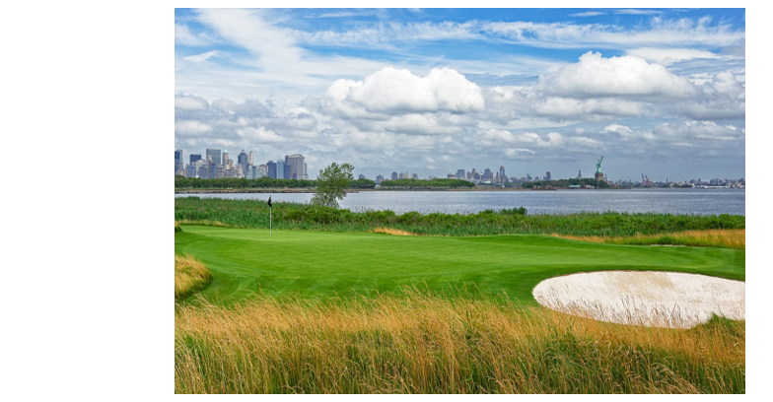
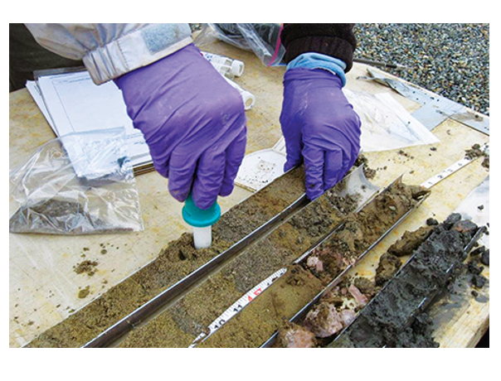
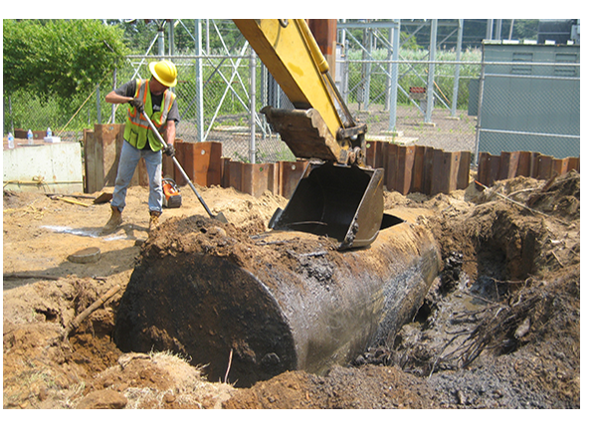
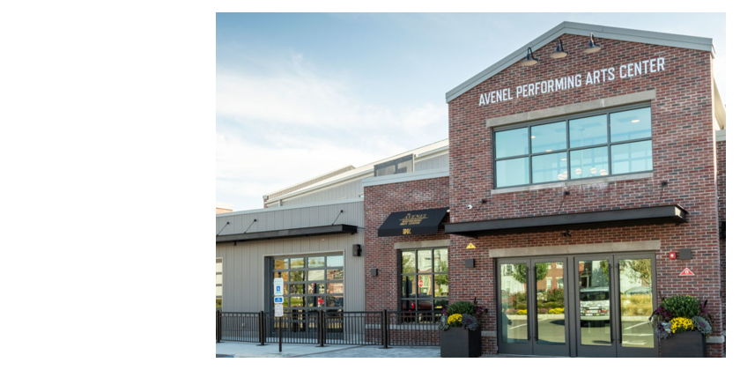
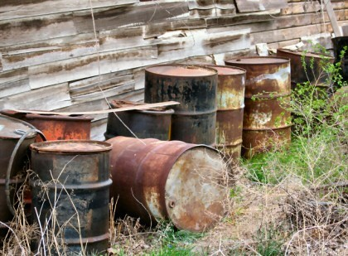
Defining Externalities in a Changing Energy Landscape
Chris Whitehead, QEP, CESM ESI – Air Practice Leader
A&WMA/Rutgers EJ Conference – Camden, NJ– September 27, 2023

Slide 2
Session Chair: Chris Whitehead – ESI, Air Practice Lead
17+ years of environmental compliance experience
National CAM for multiple large industrial clients
Qualified Environmental Professional and Certified Environmental Systems Manager
M.S. – Environmental Management and Policy – American University
Certificate – Sustainability Program Management – M.I.T.
Published numerous times on environmental justice, climate impacts, and offshore wind project development
Born, raised, and raising a family in New Jersey

Slide 3
Main Project Team Members
Dr. Kenneth Richards
Economist, Legal Scholar, Professor
University of Indiana
Dr. Panos Georgopoulos
Rutgers Climate Institute

Slide 4
ESI Consulting and Technical Services
Environmental Impact Statements
Phase I & II Environmental Site Assessments
Due Diligence Reviews
Litigation Support
Regulatory Negotiations
Ecological Services and Permitting
Soil & Groundwater investigations
Contaminant Delineation
Groundwater Monitoring & Modeling
Air Quality Permits, Monitoring & Modeling
Certified Small Business Enterprise (SBE) in New Jersey
Offshore wind planning and permitting
Compliance Plans (SPCC, RCRA, other)
Stormwater/Wastewater Permitting
Treatment, Storage and Disposal Facility (TSDF) Audits
Facility Audits
Indoor Air Quality Evaluations
Workplace/Process Hazards Assessment
TSCA Compliance
Environmental Risk Assessment
Environmental Oversight

Slide 5
Hypothesis
With so many large infrastructure projects potentially in the pipeline in the power and transportation sectors in coming years, is it possible that we could be entering a period where we see a brief uptick in ambient NO2 and PM2.5?
Per recent EPA PM2.5 NAAQS guidance, going from a NAAQS of 12 micrograms per cubic meter to 8 would reduce early deaths from respiratory illnesses by 4X.
If we project any ambient air imbalances upcoming between OBCs and non-OBCs, what policy lever may be available to remedy this?
Will helping to reduce local emission concentrations also reduce CO2 emissions and have a climate benefit?

Slide 6
Process
Survey industry experts on number and type of project in each county for the project period, 2023-2035.
Create emission profiles for each project type (list)
Use baseline NO2 and PM2.5 data from the NJDEP and PADEP (2 years of 24-hr averages)
Use InMap modeling to project impacts of each annual batch of projects and calculate deviation from current mean.
Spatial breakdown of projected impacts in OBCs and non-OBCs
Project highest volume trucking route based on posted road weight capacities and distance to highways
Trend asthma stats from NJDOH and PADOH with InMap projections
Baseline data shows strong correlation between asthma rates and elevated ambient NO2 and PM2.5
This Photo by Unknown Author is licensed under CC BY-ND

Slide 7
Survey Experts
Partners from U of I, Rutgers Climate Institute, and UCLA
Power and Transportation experts with at least 10 years experience
County planning boards
County by county projections for year 1 (2023) through year 13 (2035)
Freeform areas to detail expected types of projects
Can be submitted anonymously
Informs “Sim City” style InMap emissions projections
Not looking for precise emission targets; rather to discuss potential relationship between impacts from multiple industries in the same geographic areas. Is there a projected imbalance between OBCs and non-OBCs?
These industries and project types are not covered by the NJ EJ law.

Slide 8
Emission Profile Types – Hunting for Delta
Power
Emission increases at existing fossil power plants
New fossil power plants (unlikely)
Offshore wind port
LNG port (Very unlikely)
Transportation
Highway upgrades/repairs
Asphalt production
Warehousing (greater than 50 bays)
EV rollout (would present as negative emissions)

Slide 9
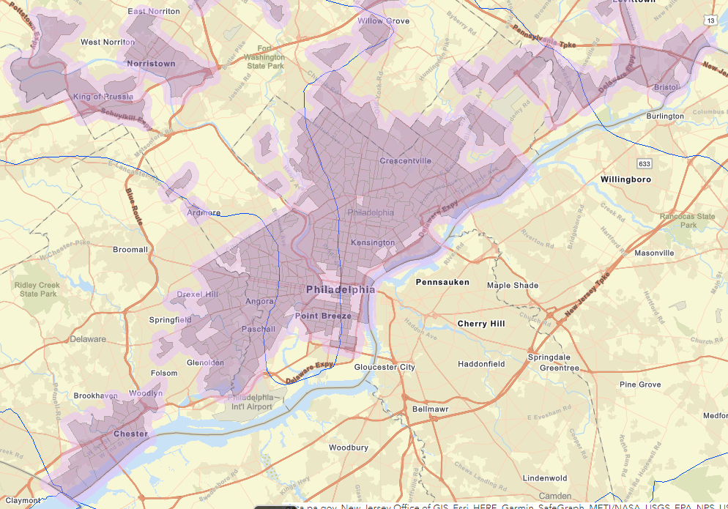
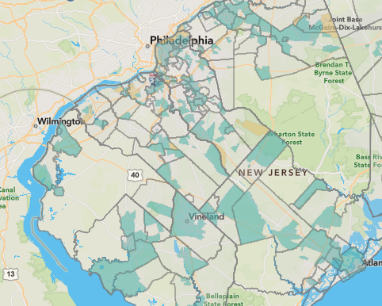
Project Area – South Jersey and Philly Area (13 total counties)

Slide 10
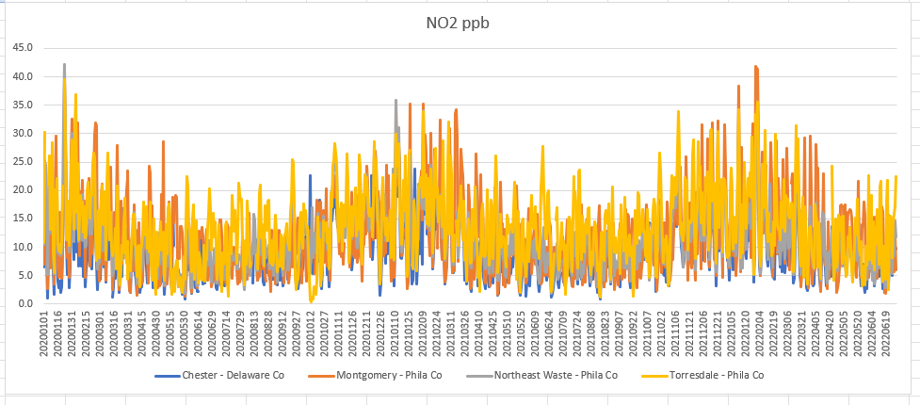
Ambient baseline – NO2 – 24 hr avg – 2020-2022 – Philadelphia area

Slide 11
Ambient baseline – NO2 – 24 hr avg – 2020-2022 – Camden, NJ

Slide 12
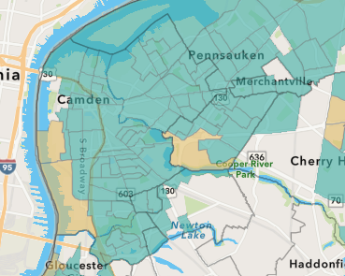
Camden County – Case Study
Nine Title V facilities within the county
Multiple major highways
Philadelphia air pollution carrying across the river
Overburdened community
Population: 523,771 (relatively static); Camden City: 71,773 (down 20% from 1990 - ~90,000)
Camden and Cumberland counties have the highest asthma rates in the state, between 6.7 and 9.2 asthma related hospitalizations per year per 10,000 residents.
Initial InMap runs show likely construction combinations staying within this range.

Slide 13
Camden County – Case Study
Interviews with planning and zoning board as well as local industry executives
Likely development areas highlighted by various operational parameters
Proximity to transportation
Skilled workforce
Property size and zoning
Existing environmental conditions
46% of likely development areas were in OBCs. ~25% of the county is classified as an OBC.
InMap hotspots found closest to Delaware River and rt 130
Sensitivity analysis (likely to not likely)
Hope to inform community monitoring and zoning

Slide 14
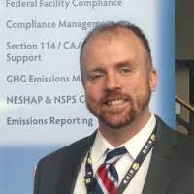
Contact Info
If you have any questions or comments about this presentation or about the Environmental Justice/Community Engagement movement in general, please contact Chris at:
732-484-1968 or
cwhitehead@esienv.com
Visit our Resource Page
for more information and a downloadable library of relevant Environmental Justice and Community Engagement resources.
For an overview of our other environmental consulting and remediation services, visit us at
www.esienv.com
ESI provides comprehensive professional consultation and field services to identify, prevent, and resolve environmental issues related to water, soil, air quality, and facilities.
With innovative technical skills and a clear understanding of our clients' goals, we effectively reduce or eliminate environmental impacts.

