Slide 1
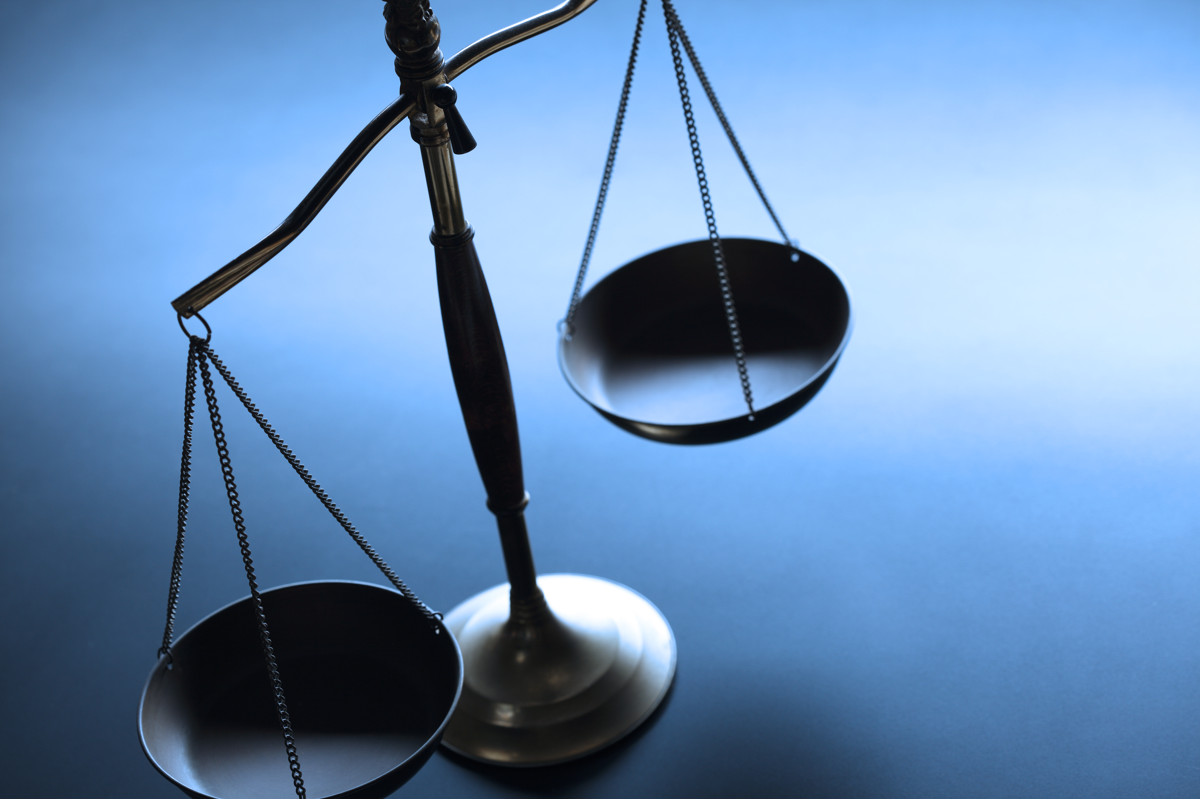
Laurie J. Sands, Esq. Associate General Counsel
ENVIRONMENTAL JUSTICE CON EDISON

Slide 2
Key Takeaways
Company is committed to Environmental Justice Concerns.
Minimize adverse environmental impacts from utility operations in disadvantaged communities.
Engage environmental justice advocates and other community stakeholders to build bridges and encourage dialogue with respect to the design and implementation of Con Edison projects and programs.
Provide disadvantaged communities benefits from our clean energy investments in terms of improved quality of life, climate-resilient energy infrastructure and workforce development opportunities.

Slide 3
Con Edison Commitments
Internal Environmental Justice Working Group
Mapping of DACs in Service Area
Determination of EJ Legal Requirements
Work with Internal Organizations to integrate EJ into Company Operations
Data Collection under Rate Case Joint Proposal
Capital Investments
Customer Outages
Main Replacement Program
Clean Energy Jobs
Community Outreach

