Slide 1
Executive Order No. 23 Update Air & Waste Management Association Conference November 16, 2018
This presentation is provided for general informational purposes only. It does not reflect any agency decision or action.
Notes:
Presentation will focus on the latest policy development for environmental justice.
Introductions
NJDEP EO-23 Team
Steering Committee and EJAC

Slide 2
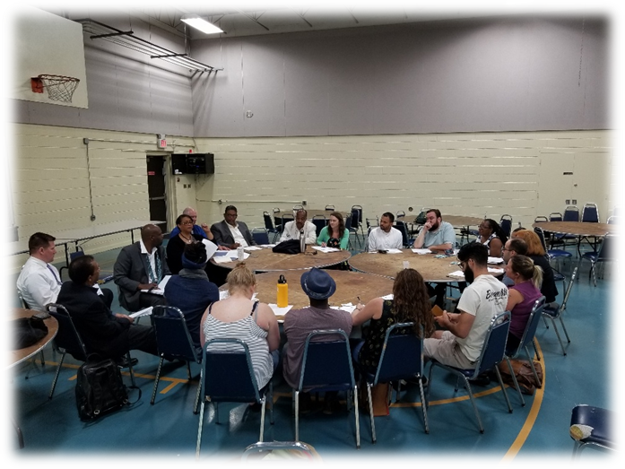
Executive Order No. 23
EO-23 signed April 20, 2018
Requires Develop of Guidance Document
Establishes Department of Environmental Protection (DEP) as the Lead Agency
Continues the Environmental Justice Advisory Council (EJAC)
Guidance to Governor October 2018
This presentation is provided for general informational purposes only. It does not reflect any agency decision or action.
Notes:
What the Guidance Document is:
Framework for State agencies and departments to follow when considering EJ in their operations, decision-making processes, and actions.
What the Guidance Document is not:
Regulation, legislation, or statutory authority for Environmental Justice.

Slide 3
EO 23 TIMELINE
First
Stakeholder
Meetings
Second
Stakeholder
Meetings
EO 23 Signed
Public
Comments
APRIL
MAY/JUNE
JULY
AUGUST
SEPTEMBER
OCTOBER
NOV/DEC
Data Collection
Draft
Outline
Draft
Document
Final Guidance January 2019
This presentation is provided for general informational purposes only. It does not reflect any agency decision or action.
Notes:
DEP EO23 Team followed this timeline
EO signed April 20
Aggressive but have built in opportunities for Stakeholders to provide input
First stakeholder meetings in July and second round on September
The 1st stakeholder meetings solicited feedback on what should be included in the guidance and helped develop categories and informed questions for second round.
The 2nd stakeholder meetings reflect the input we received in July. This round will help gather more specific feedback in priority areas identified in 1st round.
There will also be an opportunity to comment on the guidance document in November/December during a public comment period.

Slide 4
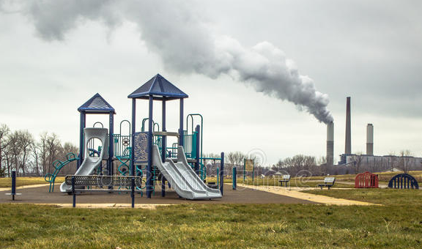
Stakeholder Discussion Topics
Priority Challenges for EJ Communities
Identification of EJ Communities
Strategic Focus for State Agencies
State Agency Coordination Ideas
Other Ideas or input
This presentation is provided for general informational purposes only. It does not reflect any agency decision or action.

Slide 5
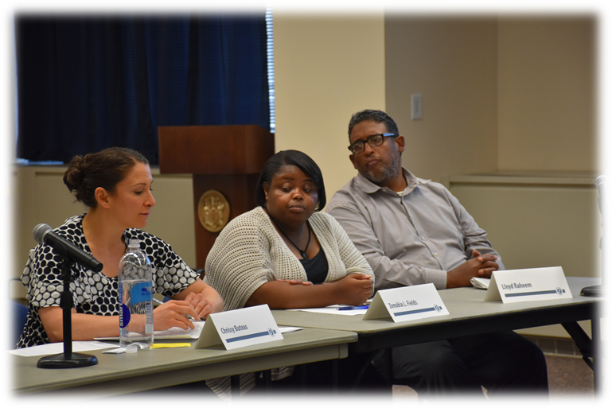
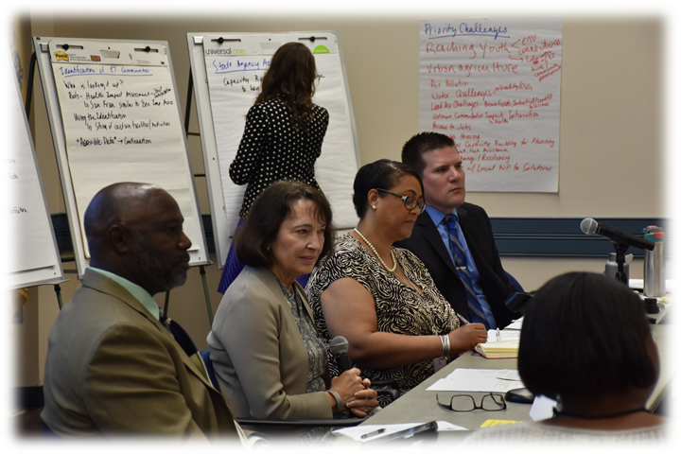
Outline Discussion
1.0 Introduction
2.0 Goals
3.0 Interagency Collaboration
4.0 State Agency Actions
5.0 Implementation and Evaluations
Appendix
This presentation is provided for general informational purposes only. It does not reflect any agency decision or action.
Notes:
Goals will be derived from EO23:
Transparency and consistency
Coordination & Collaboration
Integration of EJ
Capacity Building
Interagency Coordination
EJ Interagency Taskforce / Working Group Formation
Analysis / Screening Tool
Develop State Agency Action Plans
Each agency develops their action plans
Training
Community Outreach – improved public participation + education, …
Capacity Building – funding (prioritization, leveraging public/private partnerships) + technical assistance + place-based collaboration
Interagency Consistency – review existing interagency initiatives/workgroups and where EJ can be incorporated into them
Implementation and Evaluations
Benchmarks / measures for success

Slide 6
THANK YOU
Riché S. Outlaw
Environmental Justice Coordinator NJDEP Office of Environmental Justice
Submit comments: eo23@dep.nj.gov
Website: www.nj.gov/dep/ej
This presentation is provided for general informational purposes only. It does not reflect any agency decision or action.

