Slide 1
Environmental Justice Policy to Practice
Presented by:
Oliva Glenn
Chief of Staff and Senior Advisor for Equity
EPA Region 2

Slide 2
Environmental Justice: Background

Slide 3
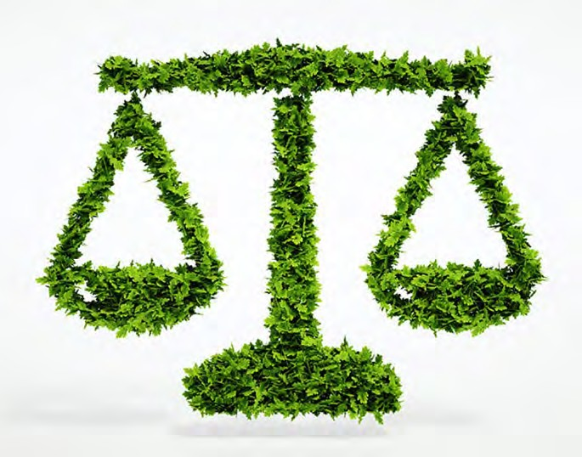
U.S. Environmental Protection Agency definition:
What is Environmental Justice?
Environmental justice is the fair treatment and meaningful involvement of all people regardless of race, color, national origin, or income, with respect to the development, implementation, and enforcement of environmental laws, regulations, and policies. This goal will be achieved when everyone enjoys:
The same degree of protection from environmental and health hazards, and
Equal access to the decision-making process to have a healthy environment in which to live, learn, and work.

Slide 4
Community Perspectives on Environmental Justice
Jemez Principles of Environmental Justice (1991)
Adopted by many EJ organizations: 17 principles of EJ
Examples:
Environmental Justice demands:
“the right to participate as equal partners at every level of decision-making, including needs assessment, planning, implementation, enforcement and evaluation.”
“that public policy be based on mutual respect and justice for all peoples, free from any form of discrimination or bias.
“the right to ethical, balanced and responsible uses of land and renewable resources in the interest of a sustainable planet for humans and other living things.
http://lvejo.org/wp-content/uploads/2015/04/ej-jemez- principles.pdf

Slide 5
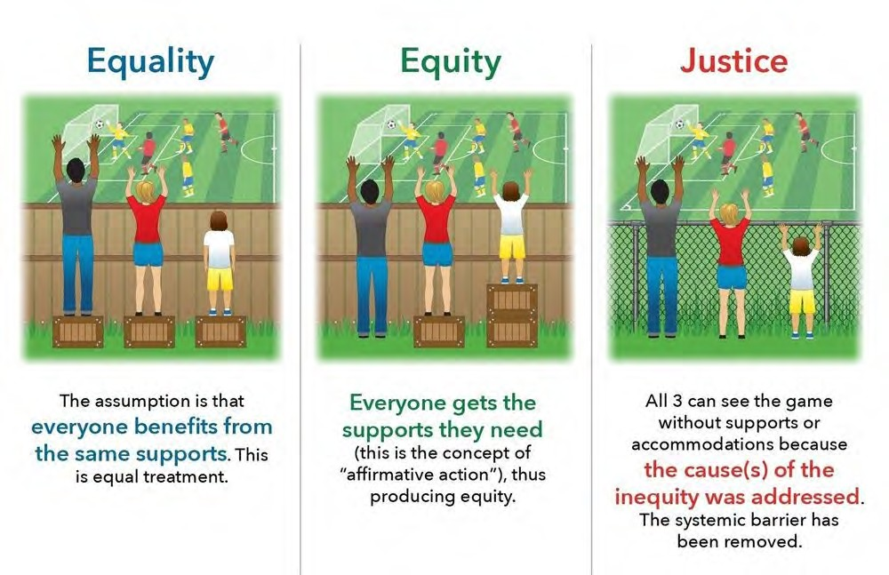
Environmental Equity v. Environmental Justice: What’s the Difference? (source MobilizeGreen)

Slide 6
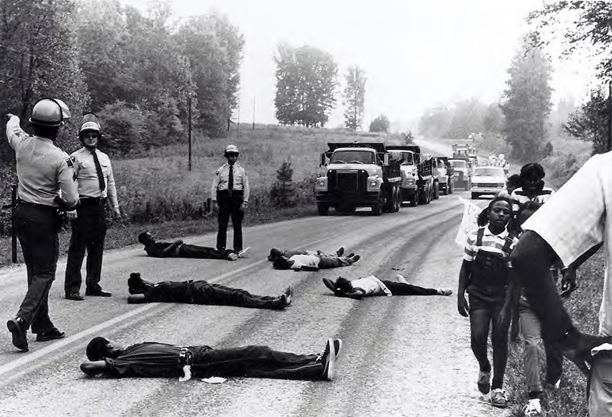
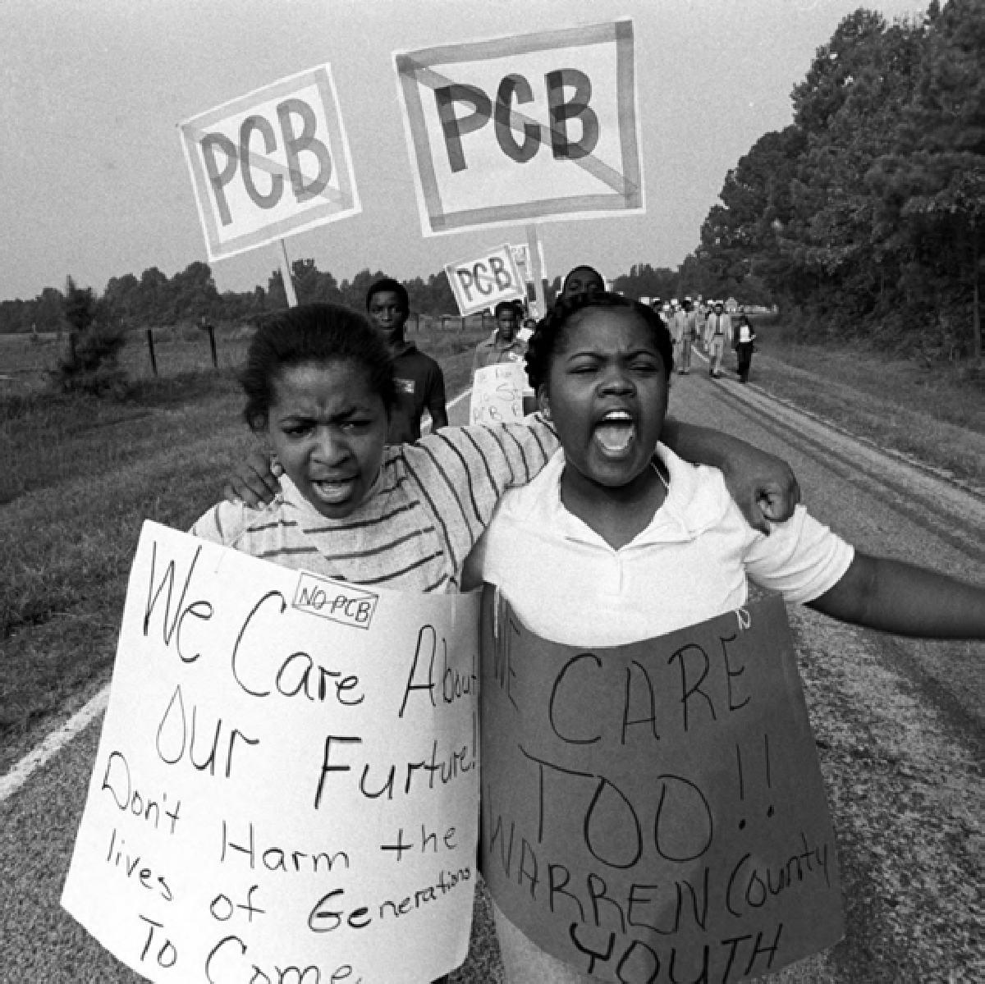
Pre-Executive Order Federal EJ History, Snapshots
EPA Environmental Justice Timeline: https://www.epa.gov/environmentaljustice/environmental- justice-timeline
Sit-in Against Warren County, NC PCB Landfill:
The second time African Americans mobilized a national, broad-based group was a nonviolent sit-in protest against a polychlorinated biphenyl (PCB) landfill in Warren County, North Carolina. Over 500 environmentalists and civil rights activists were arrested and the protest was unsuccessful in halting construction. This event is widely understood to be the catalyst for the Environmental Justice Movement.
State and EPA were faulted for placing the landfill in a poor, rural, minority community, and minimizing environmental risks, such as to groundwater.

Slide 7
Pre-Executive Order EJ History, Snapshots
General Accounting Office Study (1983)
Prompted by the 1982 Warren County sit-in, the United States General Accounting Office (GAO) conducted the study: Siting of Hazardous Waste Landfills and Their Correlation with Racial and Economic Status of Surrounding Communities (PDF). This study is said to have "galvanized the environmental justice movement and provided empirical support for the claims for environmental racism." GAO found that three out of four hazardous waste landfills examined were located in communities where African Americans made up at least twenty-six percent of the population, and whose family incomes were below the poverty level.

Slide 8
Pre-Executive Order Federal EJ History, Snapshots
Late 1980s to early 1990s
Formation of significant regional and national EJ organizations, EJ studies, and major conferences:
1988: West Harlem Environmental Action (WE ACT), created to address poorly managed sewage treatment, bus depots, other local hazards.
1990: Indigenous Environmental Network (IEN) was formed by grassroots indigenous peoples and individuals to address environmental and economic justice issues by building economically sustainable communities.
1990: Southwest Network for Environmental and Economic Justice (SNEEJ) was formed in Albuquerque, New Mexico at the People of Color Regional Activist Dialogue on Environmental Justice. Regional organization composed of African American, Latino, Native American, and Asian/Pacific Islanders.

Slide 9
Pre-Executive Order Federal EJ History, Snapshots
1990: The Congressional Black Caucus met with EPA officials to discuss their findings that environmental risk was higher for minority and low-income populations.
1990: EPA creates the Environmental Equity Workgroup to address the allegation that ‘racial, minority, and low-income populations bear a higher environmental risk burden than the general population.’ Issues report in 1992 with recommendations to address inequality.
1991: The First National People of Color Environmental Leadership Summit was held in Washington, D.C. Several hundred people who identify as Native American, African American, Latino, and Asian Pacific attended and adopted 17 Principles of Environmental Justice (PDF) as a comprehensive platform for a national and international movement of all people (Jemez EJ principles).
1992: The EPA Office of Environmental Equity was established, based on recommendations from the Environmental Equity Workgroup. In 1994, the name was changed to the Office of Environmental Justice.
1993: EPA created the National Environmental Justice Advisory Council (NEJAC). NEJAC is a federal advisory council that holds public meetings on environmental justice issues across the nation.

Slide 10
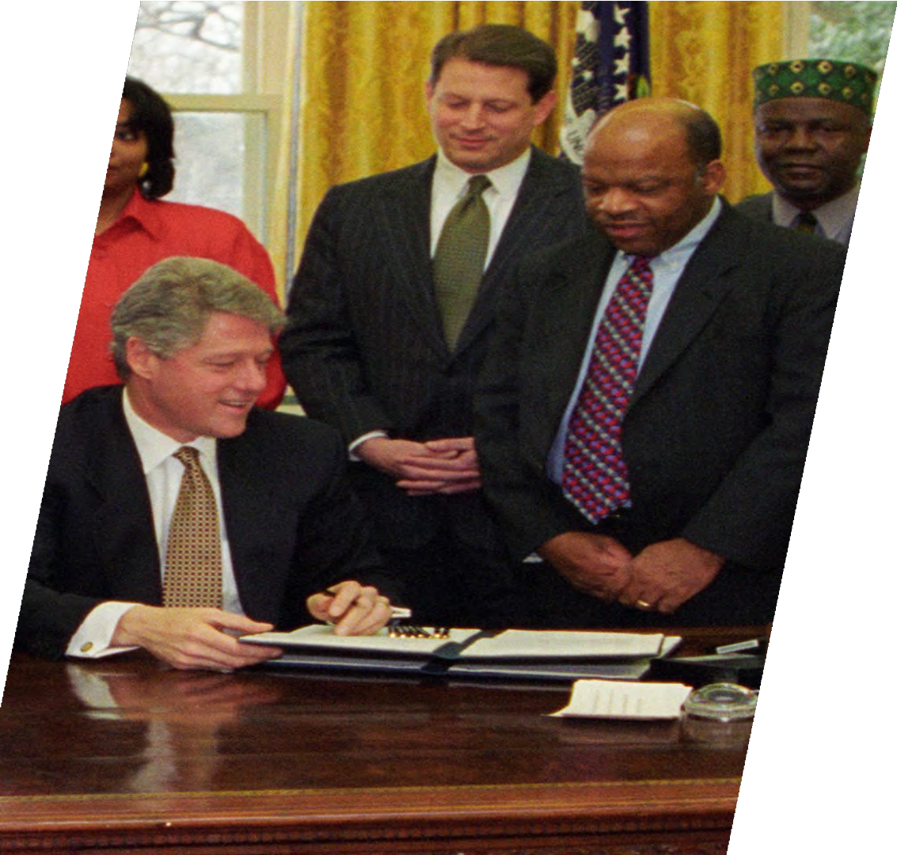
Executive Orders on Environmental Justice
Executive Order #12898 (1994)
President Clinton stated:
“Each Federal agency shall make achieving environmental justice part of its mission by identifying and addressing, as appropriate, disproportionately high and adverse human health or environmental effects of its programs, policies, and activities on minority populations and low-income populations”
In 2011, several federal agencies, pursuant a Memorandum of Understanding on Environmental Justice, renewed their commitments to Executive Order 12898 through the foundation of the Interagency Working Group of Environmental Justice (“EJ IWG”). The agencies participating in the working group were charged with identifying the disproportionately significant adverse environmental effects of their continuing programs and with determining such effects for future programs.

Slide 11
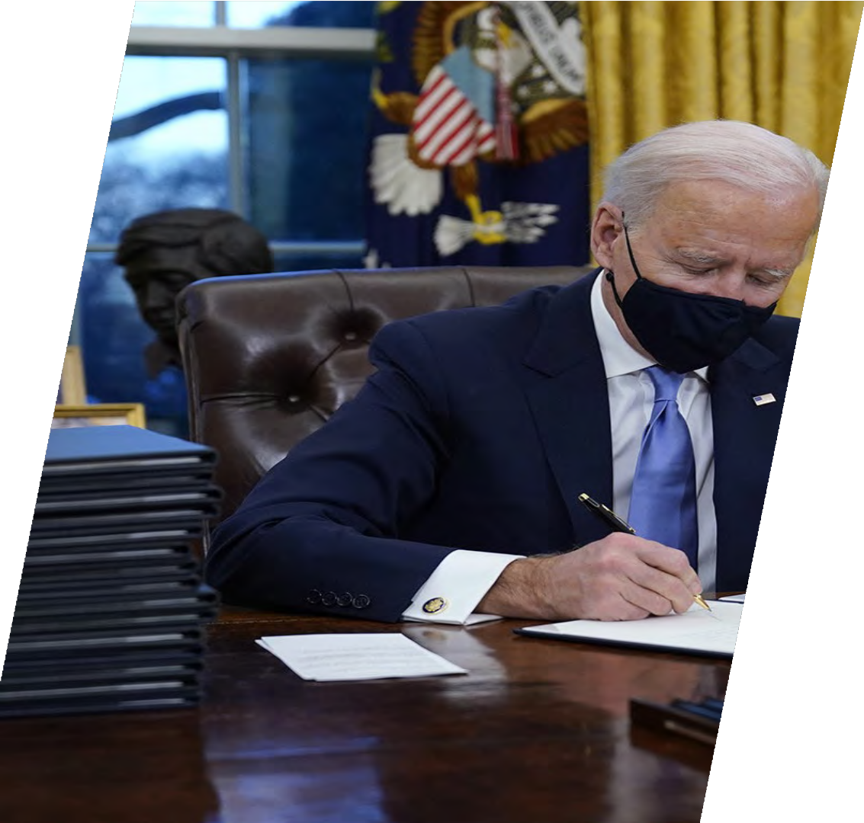
Executive Orders on Environmental Justice, E.O. 14008
Executive Order 14008, President Biden:
Tackling the Climate Crisis at Home and Abroad
“To secure an equitable economic future, the United States must ensure that environmental and economic justice are key considerations in how we govern. That means investing and building a clean energy economy that creates well-paying union jobs, turning disadvantaged communities — historically marginalized and overburdened — into healthy, thriving communities, and undertaking robust actions to mitigate climate change while preparing for the impacts of climate change across rural, urban, and Tribal areas.”

Slide 12
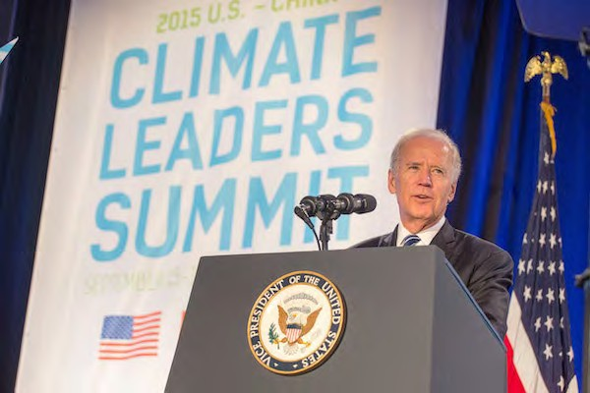
Executive Orders on Environmental Justice E.O. 14008
“Agencies shall make achieving environmental justice part of their missions by developing programs, policies, and activities to address the disproportionately high and
adverse human health, environmental, climate-related and other cumulative impacts on disadvantaged communities, as well as the accompanying economic challenges of such impacts. It is therefore the policy of my Administration to secure environmental justice and spur economic opportunity for disadvantaged communities that have been historically marginalized and overburdened by pollution and underinvestment in housing, transportation, water and wastewater infrastructure, and health care.” (emphasis added)

Slide 13
Executive Orders on Environmental Justice, E.O. 14008
Justice 40 Initiative:
The order creates a government-wide Justice40 Initiative with the goal of delivering 40 percent of the overall benefits of relevant federal investments to disadvantaged communities and tracks performance toward that goal through the establishment of an Environmental Justice Scorecard.

Slide 14
EPA’s Implementation of Environmental Justice and the Justice 40 Initiative

Slide 15
EPA Strategic Plan FY 2022-2026 (March 2022)
One of EPA’s overarching goals under the new Administration: “Take Decisive Action to Advance Environmental Justice and Civil Rights”
Goal 2: Take Decisive Action to Advance Environmental Justice and Civil Rights
“EPA will center its mission on the integration of justice, equity, and civil rights across the nation’s environmental protection enterprise.”
“EPA’s ultimate goal… is to achieve measurable environmental, public health, and quality of life improvements in the most overburdened, vulnerable, and underserved communities.”
Goal 3: Enforce Environmental Laws and Ensure Compliance
“EPA will focus federal enforcement resources on the most serious environmental problems where noncompliance with environmental statutes and regulations is a significant contributing factor and where federal enforcement can have a significant impact on the nation’s air, water, and land.... [T]his work will include targeting and screening to prioritize inspections in communities facing substantial burdens from environmental noncompliance.”
By 2026, EPA plans to conduct 55% of inspections annually at facilities that trigger potential environmental justice concerns.
EJ is also embedded in the other goals as well

Slide 16
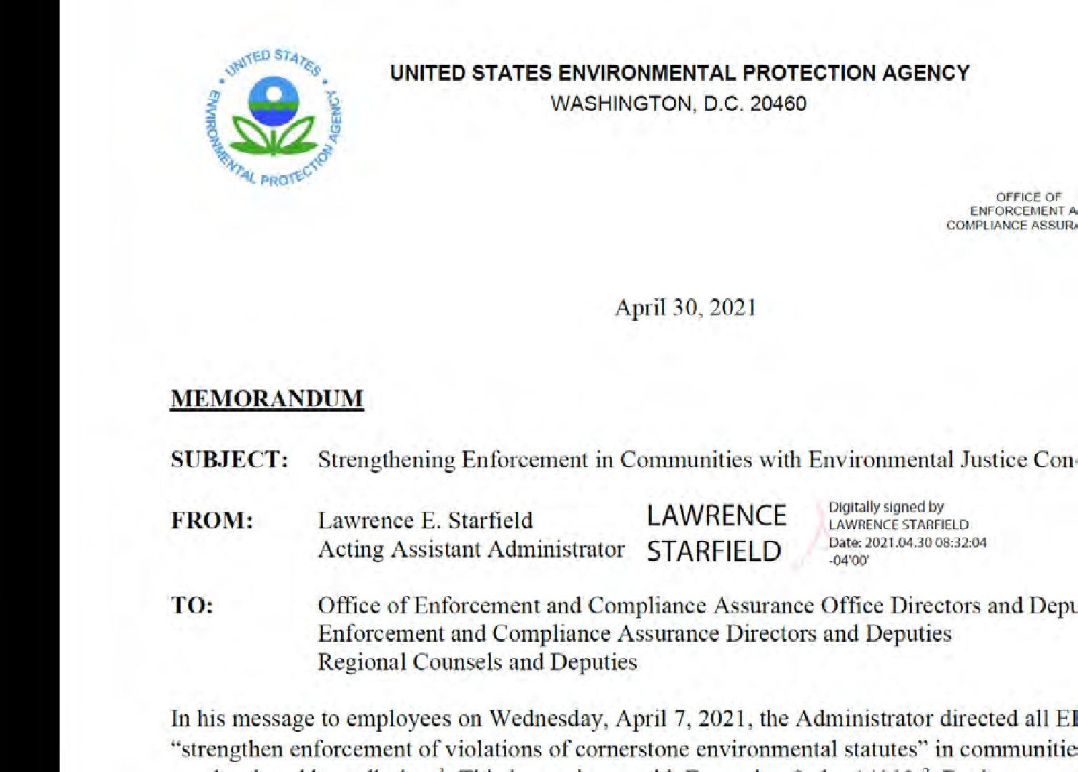
Incorporating EJ Considerations into EPA’s Enforcement Program
4/30/21 Memo from OECA Acting AA: “Strengthening Enforcement in Communities with Environmental Justice Concerns”
Implementation of this policy is high priority for EPA’s enforcement program.
Builds on Pres. Biden’s Executive Orders and directions from Administrator Regan to prioritize environmental justice

Slide 17
Strengthening Enforcement in Communities with Environmental Justice Concerns
April 30, 2021 EPA memo (cont’d):
Increase number of facility inspections in overburdened communities and continue use of off-site compliance monitoring tools as well.
Strengthen enforcement in overburdened communities by resolving noncompliance through remedies w/ tangible benefits for the community.
Prevent further pollution due to noncompliance, mitigate past impacts from pollution, and seek penalties for violations.
Seek early and innovative relief to benefit communities (see the tandem guidance on “Using All Appropriate Injunctive Relief Tools in Civil Enforcement Settlements,” EPA-OECA, 4/26/21). For example:
Seek a preliminary injunction to stop noncompliance
Advanced environmental monitoring technologies and approaches
Company-wide compliance audits or independent third-party verification
Electronic reporting of data
Give the public greater access to compliance and monitoring data

Slide 18
Strengthening Enforcement in Communities with Environmental Justice Concerns
April 30, 2021 EPA memo (cont’d):
Incorporate Supplement Environmental Projects in settlements, where appropriate
A SEP is an environmentally beneficial project that a violator agrees to undertake in settlement of an enforcement action, but that is not otherwise required by law.
SEPs can secure significant environmental and public health benefits that help address the needs of communities, esp. in cases raising EJ concerns.
Feb. 4, 2021 DOJ memo withdrew prior Administration’s memos that blocked use of SEPs in civil settlements, but Dec. 2020 DOJ regulation, 28 CFR §50.28, remains on books and appears to continue to restrict SEPs. DOJ is reconsidering the regulation.
OECA: “Until further guidance is provided, inclusion of SEPs and stipulated remedies in civil judicial settlements should be limited to those that involve diesel emission reductions.”
Increase engagement with communities about enforcement cases that most directly impact them.
Provide more information to communities about facilities, pollution, and enforcement activities

Slide 19
EJSCREEN is EPA’s web-based GIS tool for nationally consistent EJ screening and mapping
Combines publicly available environmental and demographic data to highlight areas where vulnerable populations may be disproportionately impacted by pollution
The EJSCREEN tool and info on how to use it are at: https://www.epa.gov/ejscre en

Slide 20
Thank you!

