Slide 1
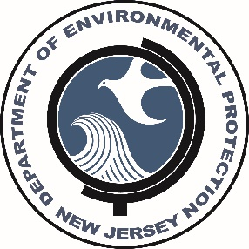
Division of Science and Research
2018 Update on Current and
Recent Research
Nicholas A. Procopio, Ph.D.
Chief, Bureau of Environmental Assessment
Division of Science and Research
NJDEP
November 16, 2018
DEP/AW&MA Conference

Slide 2
DSR Goals:
Provide the department with, and access to, expertise and information that supports its technical, program and policy needs.
Act as liaisons to the Science Advisory Board and Standing Committees that will help provide the DEP with outside expertise on scientific issues.
Perform research to meet the information and problem-solving needs of the department, and to identify and understand emerging issues that require the department's attention and response.
Advocate and integrate the multi-disciplinary perspective into the department's identification, analysis and resolution of environmental issues.

Slide 3
Staff Expertise
Toxicologists/Risk Assessment
Biologists/Ecologists
Air Quality/Modeling Specialists
Water Quality Specialists
GIS
Chemist
Statistician
Microbiologist
Environmental Scientists

Slide 4
Science Based Support
Air Monitoring/Modeling
Fish Monitoring & Consumption Advisories
Human Health Risk Assessment
Standards Development
Data Analysis & Interpretation
Analytical Chemistry
Field Investigations and Sample Collection
Literature Reviews

Slide 5
Science Advisory Board
NJDEP COMMISSIONER
DSR
SCIENCE ADVISORY BOARD
CLIMATE & ATMOSPHERIC SCIENCES COMMITTEE
ECOLOGICAL PROCESSES COMMITTEE
PUBLIC HEALTH COMMITTEE
WATER QUALITY & QUANTITY COMMITTEE
AD HOC COMMITTEE(S)
DEPARTMENT STAFF
PUBLIC

Slide 6
SCIENCE ADVISORY BOARD - COMPLETED
Completed 2018
Long-term Effects of Eutrophication
Impacts of Dredging and Dredge Material Management on Coastal Ecosystems
Role of Omics (e.g., metabolomics, genomics) and use by DEP for human health risk assessment
Completed 2017
Re-use and Disposal of Hatchery Fish diseased by Furunculosis – April 2017
Marine Dissolved Oxygen – April 2017
Acrylamide Monomer - April 2017
See http://www.state.nj.us/dep/sab/

Slide 7
Science advisory board – ongoing Work
What are potential human health and environmental exposures to asphalt millings or RAP?
How can the DEP be proactive in working with citizen scientists throughout the state?
What are the actual or potential impacts of seismic testing on ocean resources?
Is there a way of looking at contaminants of emerging concern (CECs) in a broader context and how should DEP approach and manage the thousands of chemicals in use today?
How could pipeline installation and operation affect groundwater quality in those areas of the Piedmont province?
What are the potential impacts to groundwater and air from outdoor food waste composting?
What are potential effects on drought, streamflow and flooding in terms of recent weather patterns, broad weather patterns, and expected climate change?

Slide 8
Completed Research

Slide 9
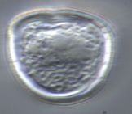
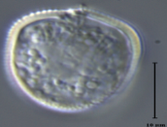
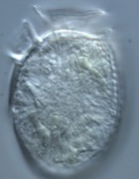
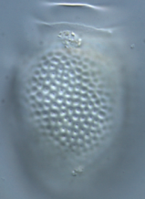
Development of Phytoplankton Index of Biotic Integrity (P-IBI) in Barnegat Bay–Little Egg Harbor
Project objectives:
Develop season-salinity specific phytoplankton index of biotic integrity (P-IBI) for BB-LEH.
To understand the relationships between the changes of species composition and environmental variables.
Results:
P-IBI scores showed good separation between impaired and least-impaired for most season-salinity zones, correctly classifying 57-81% of the calibration set samples.
Project provided additional data necessary to refine P-IBI development in BB-LEH.
Report completed in early 2018
Notes:
Main objectives are first, to characterize phytoplankton spatial and temporal variation over 3 years, includng documenttaion of harmful algal blooms.
Then, to investigate relationships between species composition and the Bay's environmental variables and investigate the possibility to develop a phytoplankton index of biotic integrity

Slide 10
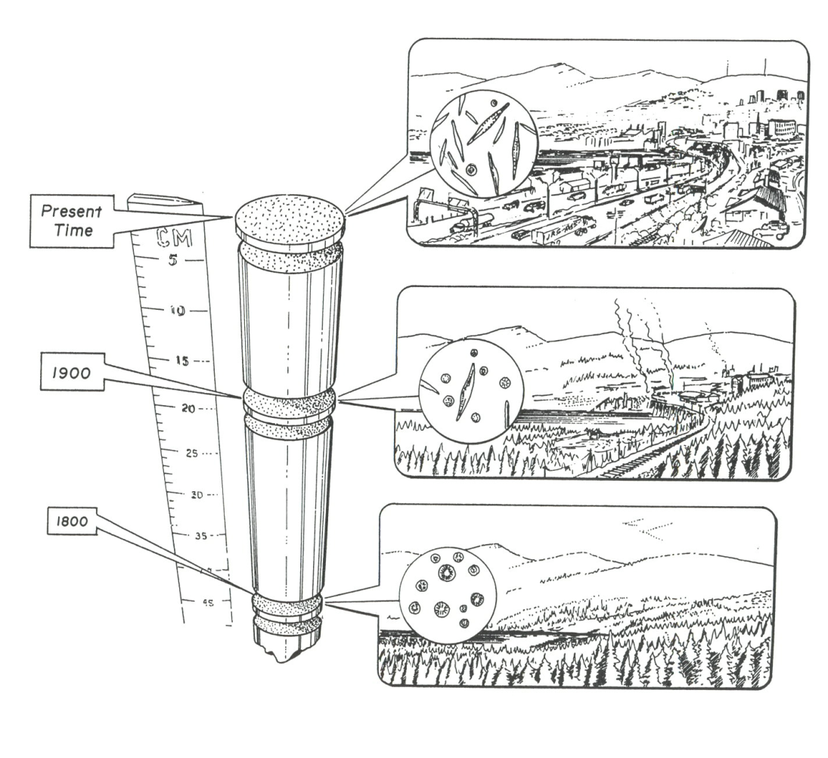
NJ Wetlands Past, Present and Future (EPA Grant)
Lack of reference conditions is a knowledge gap.
Reconstruction of wetland systems based on investigations of sediment cores.
Objectives:
  Assess wetland reference conditions and impact of anthropogenic activities.
  Assess the impact of climate and natural events on wetland characteristics.
  Refine the use of diatom species as indicators of wetland ecological condition.
Completed December 2017

Slide 11
Diatom Research
Assessment of Barnegat Bay condition based on sediment core analysis - assess historical conditions and the impact of human activities on Barnegat Bay based on diatom assemblages.
  Provides quantitative evaluation of changing nutrient conditions in the bay.
Use DNA-metabarcoding of diatom assemblages for biomonitoring of New Jersey streams – develop procedures to identify diatom assemblages using molecular techniques in addition to morphological techniques.
Notes:
Cooperative projects with NRCS and ANS.

Slide 12
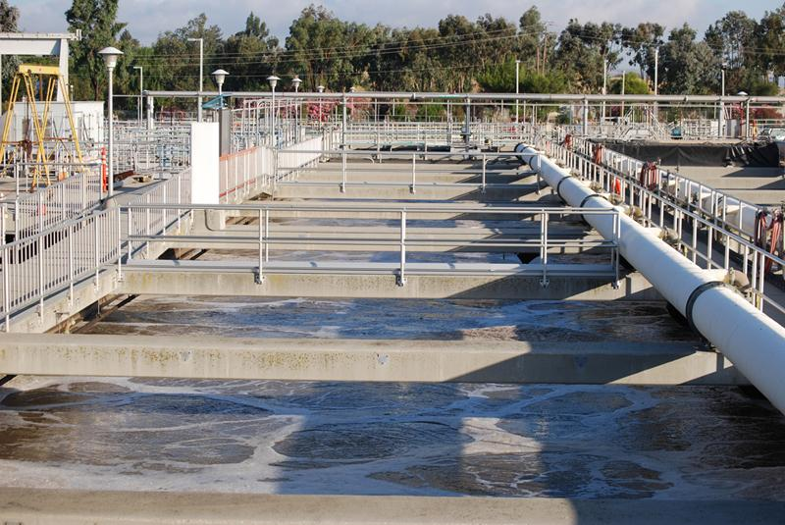
A Reconnaissance of Contaminants of Emerging Concern in Wastewater and Sludge in NJ
General questions:
  Do pharmaceutical processing plants, hospitals, or other human waste sources represent significant sources of APIs and other CECs to POTWs?
  What APIs and other CECs are released at the outfalls of large POTWs?
  What APIs and other CECs are present in solid bio-solids produced by POTWs?
Overall, in the nineteen samples taken from wastewater sampling locations, every site had a detectable level of at least nine pharmaceutical compounds.
It appears that the wastewater treatment plants reduced the number and concentration of pharmaceuticals detected.
Notes:
API = active pharmaceutical ingredients
publicly owned treatment works (POTW).
Also evaluated Pesticides, Hormones, Flavor and fragrances, phenol, PAH. PFAS

Slide 13
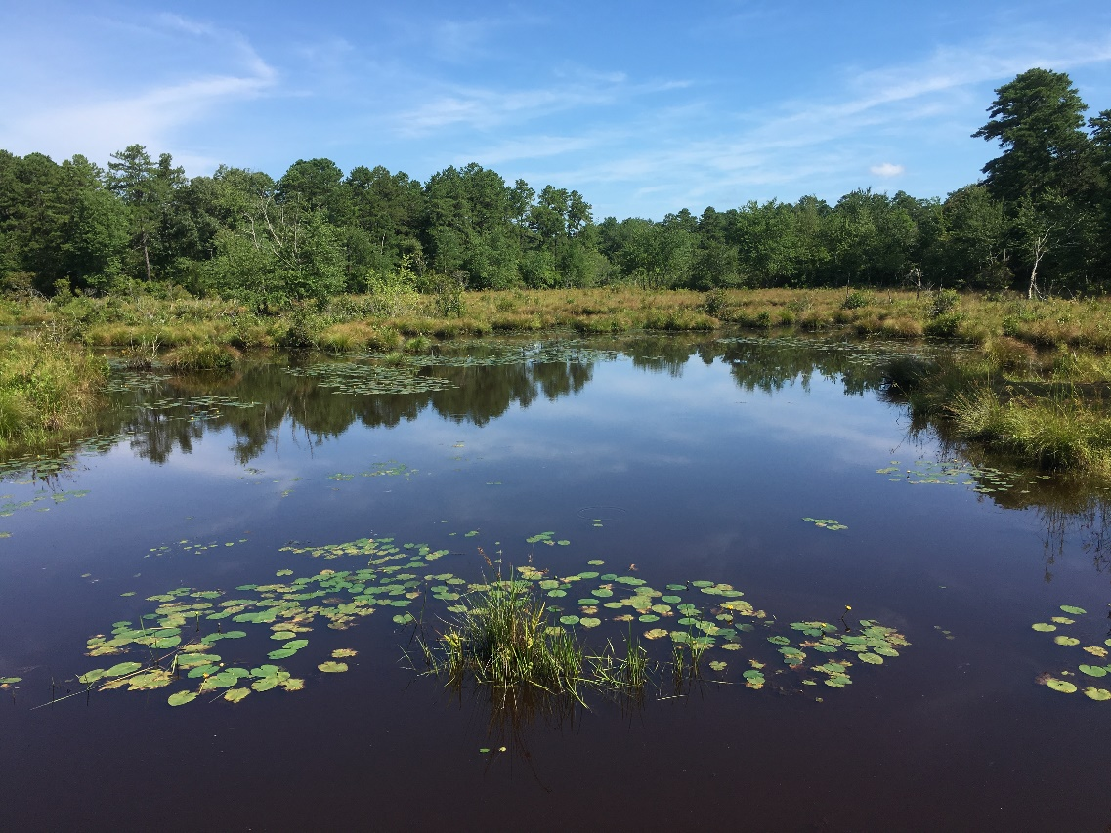
Investigation of Levels of PFAS Compounds in Fish, Surface Water, and Sediment
Surveyed 11 waterways and 14 locations
PFAS detected in all three matrices
PFOS found to accumulate in fish tissue
PFAS detected even in fish from Echo Lake, a background high elevation lake.
Results provided guidance to establish fish consumption advisories for the monitored lakes and streams.

Slide 14
Active Research

Slide 15
Environmental Trends
39 chapters on the status of key environmental parameters
Updated as new data become available
Provides a summary of a major environmental issue
Each chapter includes references, DEP contacts, and sources of additional information
Ten reports updated since last November.
https://www.nj.gov/dep/dsr/trends
Figure 1: Annual mercury emissions from NJ coal-burning power plants
Notes:
#1 = Climate Change, #2 White-tailed deer, #3 Beach Closings, #4 Solid Waste and Recycling, #5 Endangered Plants

Slide 16
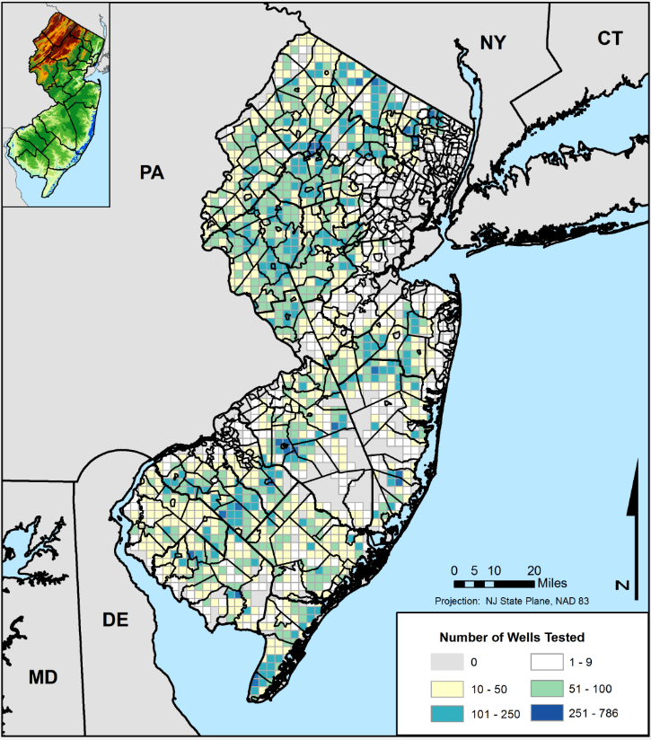
New Jersey Private Well Testing
Approximately 400,000 private wells (13 % of residents) in NJ.
Wells are required to be tested for bacteria, nitrates, 26 volatile organic compounds, lead, pH, arsenic, gross alpha (radionuclides), iron, and manganese. Mercury and uranium are only required in certain counties.
Analysis of data show the variability in the concentration for each parameter in relation to state standards.
Data from the PWTA can be used to identify vulnerable communities and direct outreach efforts.
Data is also used by SDW, SRP, and NJGS.
http://arcg.is/1CPkHyC

Slide 17
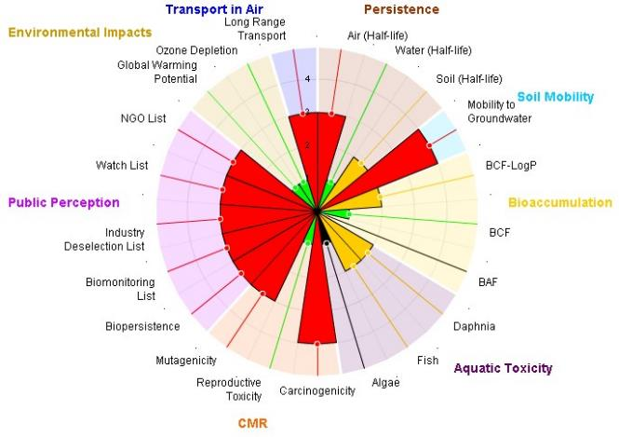
NJRISK
DEP has a need to evaluate the hazardous effects and exposure potential of chemicals in various environmental media
Computational tool to provide immediate information about chemical contaminants
  Combining METIS and Protégé databases developed by DuPont and Rutgers University
Notes:
Training provided by Rutgers.
Year 4 primarily funds maintenance and access.

Slide 18
USGS Cooperative projects:
Natural Background Investigation of Arsenic and Vanadium concentrations in glauconitic soil and sediments in central NJ
This study is evaluating elevated trace metal concentrations in soils by re-examining presumed natural (background) ranges for geogenic sources and to determine probable regional extent of strata or horizons showing the greatest enrichment. Supports implementation of the Remediation Reform Act (SRRA).
Analysis of total mercury and mercury isotopes in groundwater of the Kirkwood-Cohansey Aquifer
Assessing and identifying the source of mercury through the use of isotope analysis as a “fingerprinting” tool. Such identification can help regulators make informed decisions and direct policies that aim to reduce mercury exposure to fish, wildlife, and humans.
Notes:
Elevated levels of arsenic and vanadium (As/V) were detected at multiple locations along the Route 130 corridor with no associated industrial discharge or agricultural arsenical pesticide/fungicide usage.

Slide 19
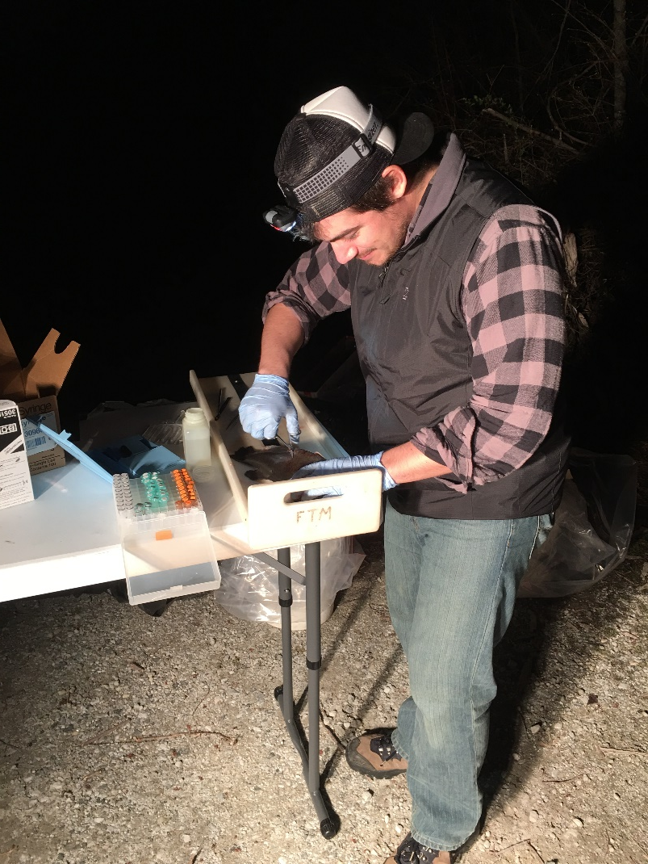
Endocrine Disrupting Chemicals and Prevalence of Intersex in Fish populations in NJ (USGS)
Objectives:
Determine if endocrine disrupting chemicals are present at varying levels in NJ waters and if so, are those levels related to land-use within the watersheds.
Determine if the concentration of endocrine disrupting chemicals are positively correlated to the frequency and severity of intersex fish residing within those streams.
Status:
Preparing final report
  Collected water-quality samples from 100 sites to assess hormone activity in water.
  Collected fish (smallmouth bass) from 9 sites with range of hormone activity levels.
  Conducted histology assessment to identify the presence of intersex in fish.

Slide 20
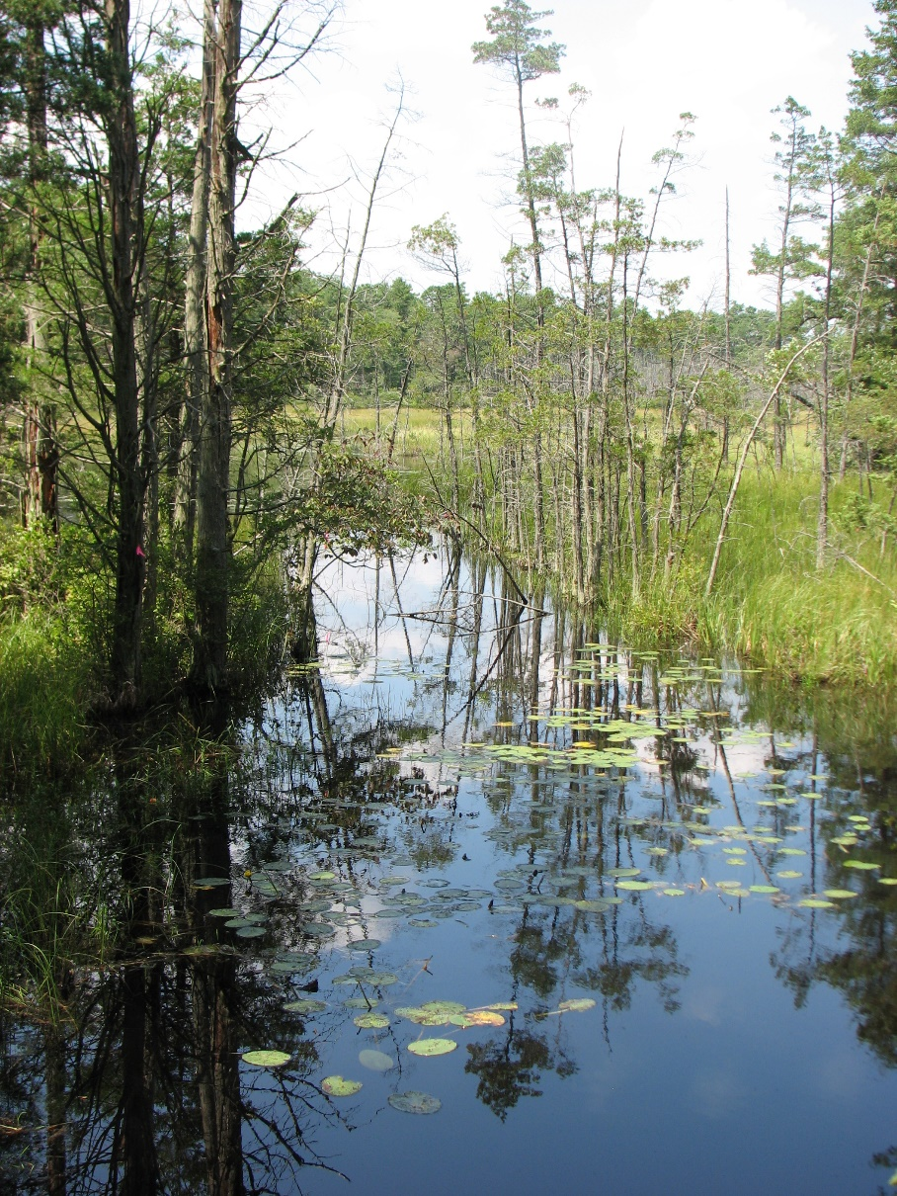
Arsenic Benchscale Treatability of Wastewater
Objective:
NJ has a surface water quality standard of 0.017 µg/L for arsenic which is often difficult to meet. This bench scale investigation looks at the treatability of arsenic in wastewater using various existing technologies.
Phase 1. Chemical Analyses of Wastewater and Sludge
Phase 2. Treatment of Wastewater Samples Collected from the Primary Clarifier Effluent and Aeration Tanks
Phase 3. Treatment of water samples collected from the effluent of the secondary clarifiers
Notes:
If Phase 2 proves to remove total arsenic to less 3.0 µg/L, the experiments in Phase 3 will not be conducted.

Slide 21

Polycyclic Aromatic Hydrocarbon Study
Objectives:
Phase I - determine background levels of the contaminants throughout New Jersey and assess potential relationships between PAH concentrations and characteristics including depth of sample, county, population density, distance to nearest known contaminated site, forested versus open areas, and metal concentration.
Phase II - determine whether there was a change in PAH concentrations as distance from potential sources, such as railroads and asphalt surfaces, increased.
Notes:
Status:
Finalizing results and reports

Slide 22
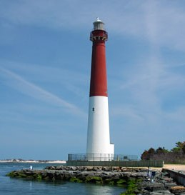
Barnegat Bay

Slide 23
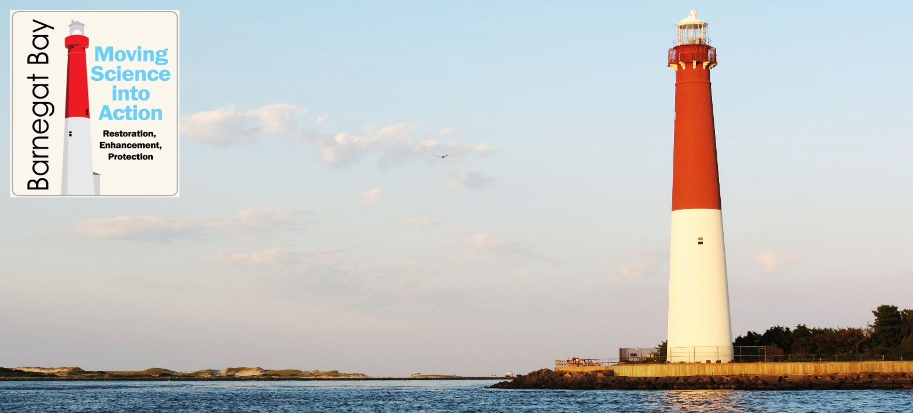
Barnegat Bay Research - status
Additional research underway/completed
Baseline conditions & relative health of the bay
Barnegat Bay: Moving Science into Action (Phase Two) http://www.nj.gov/dep/barnegatbay/
Notes:
Up to $10M in grants are available in SFY 18 for watershed restoration, enhancement, and protection strategies that address NPS pollution within the Barnegat Bay Watershed

Slide 24
Barnegat Bay Research – Additional Research
Ecosystem monitoring of pre- and post-closure of Oyster Creek Nuclear Generating Station.
  Assessment of the impacts of the OCNGS on gelatinous zooplankton and planktonic community structure (Montclair)
  Assessment of the effect of cooling water effluent on fish, crab, and benthic invertebrates (Rutgers and Rider Univ.)
  Study of zooplankton for monitoring and assessment of the closure Oyster Creek Nuclear Plant (Monmouth Univ.)
  Characterization of phytoplankton community changes in Barnegat Bay related to the closure of Oyster Creek Nuclear Generating Station, combining next generation sequencing and microscopy analyses (George Mason Univ.)
Notes:
Up to $10M in grants are available in SFY 18 for watershed restoration, enhancement, and protection strategies that address NPS pollution within the Barnegat Bay Watershed

Slide 25
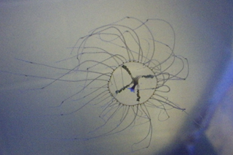
Assessment and Distribution of Clinging Jellyfish (MSU)
Objectives (year 3):
Extent of clinging jellyfish in Shrewsbury River, Manasquan River & northern Barnegat Bay.
Are medusa being transported to other waters?
What is the reproductive potential in these waters?
Status:
2018 Field sampling in the Shrewsbury and Manasquan Rivers, and Northern Barnegat Bay complete.
Jellyfish Attracting Devices (JADs) and docks analyzed for clinging jellyfish polyps.
DNA sequencing and analyses on all media conducted.
NJDEP Interactive clinging jellyfish map updated to track confirmed sightings.

Slide 26
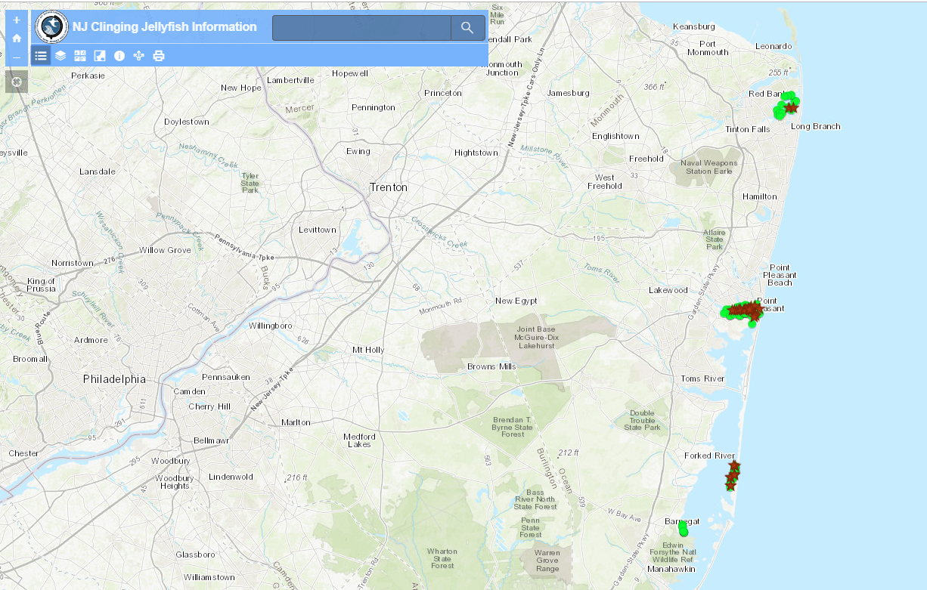
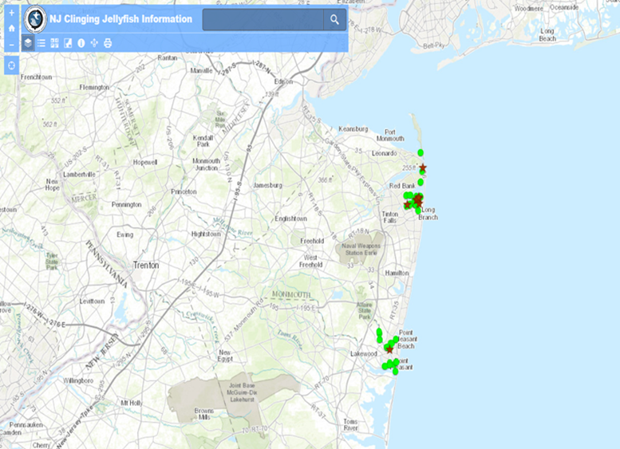
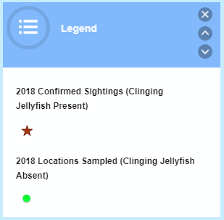
Clinging jellyfish – Invasive SPECIES
2018
2017

Slide 27
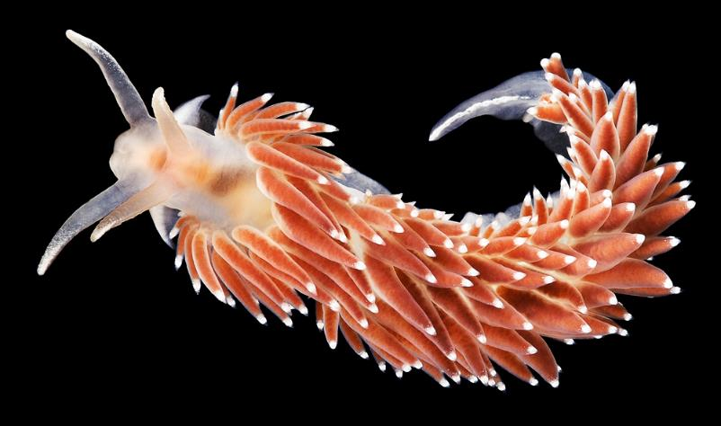
Biological Control of Sea Nettles using Nudibranchs (Montclair State University)
Objectives:
Identify potential nudibranch predators of sea nettle polyps in Barnegat Bay.
Assess nudibranch potential as a biological control of sea nettle polyps.
Field assessment of nudibranch feeding.
Status:
50 laboratory feeding trials on sea nettle polyps with a few different Nudibranch species.
Field based experiments conducted
DNA analysis ongoing for species identification.
Coryphella sp. Source: njscuba.net
Notes:
few different species of

Slide 28
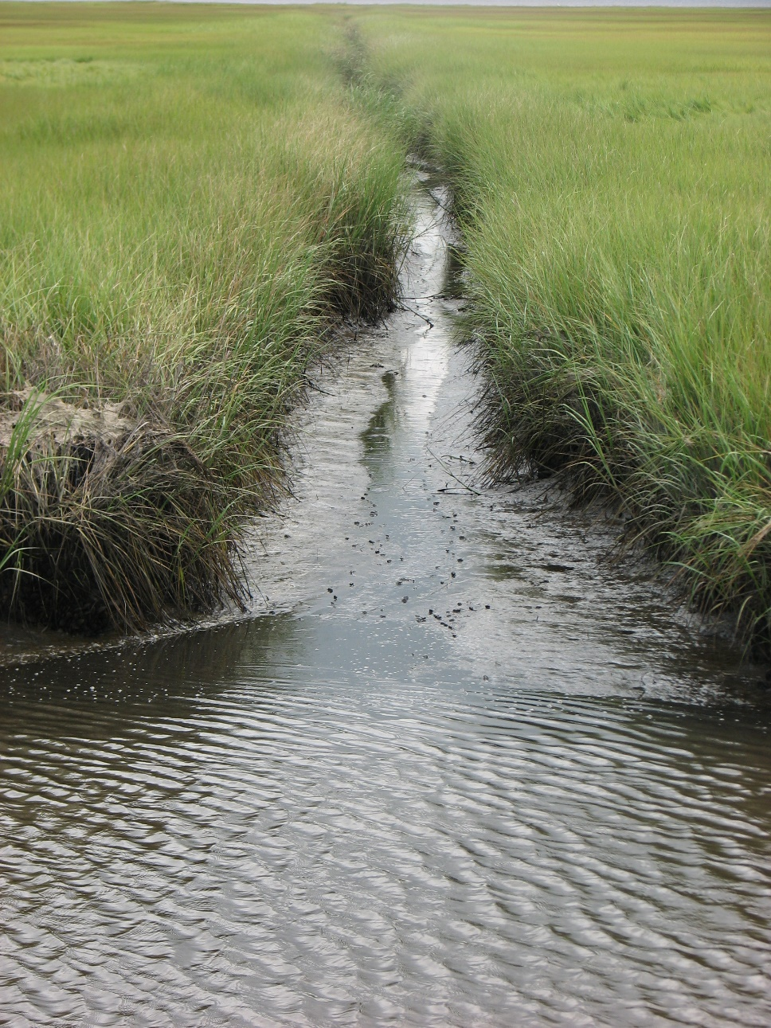
Nutrient and Carbon Fluxes to Barnegat Bay from Marginal Saline Wetlands (USGS and ANS)
Goals and Objectives
Measure nutrient and carbon exchange between the tidal streams flowing through marginal saline wetlands of Barnegat Bay.
Determine whether the marshland surrounding the creek is acting as a source or sink of nutrients as they are transported from the uplands, through the marsh complex into the bay
The results will provide information needed to integrate wetlands into the Barnegat Bay geochemical model and determine how marsh creeks impact nutrient loading.
Notes:
The hypothesis is that the input of nutrients from the watershed will be modified and in some cases reduced as they flow through the marginal wetlands and into the Bay.

Slide 29
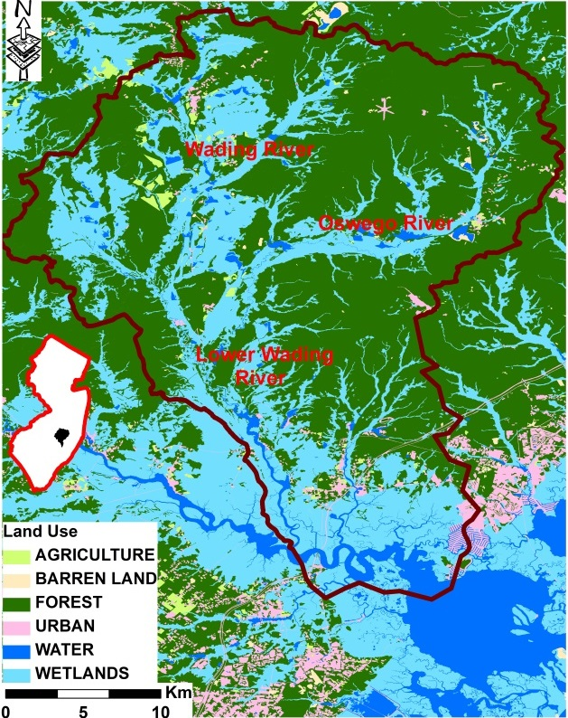
Developing a Wetland Baseline at the Watershed Scale (EPA Grant)
Up to 80% of commercial/recreational fishes, shellfish and their forage base in coastal regions have “estuarine dependent” early life stages.
Objectives:
  conduct a meta-analysis of existing literature that relates the role of riverine fresh, tidal fresh, and tidal saline marshes as essential habitat for the secondary production of fauna:
  use aerial photo interpretation and remote sensing to develop qualitative measures of vegetation coverage, diversity, and “health”;
  establish quantitative metrics that relate marsh geomorphology to species access.

Slide 30
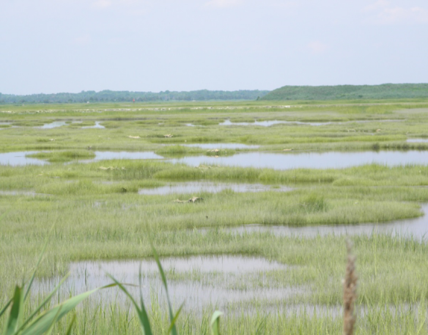
Developing a Metric to Identify and Rank the Status of NJ Coastal Wetlands (EPA Grant)
Monitoring of the various coastal wetland systems throughout NJ would enable us to compare, contrast and make informed decisions on the status, trends, health and continued ability of wetlands to provide ecosystem services.
Objectives are to:
  Develop a decision making matrix of science-based metrics to identify, quantify and rank the status of wetland degradation and link to the most appropriate restoration technique(s);
  Expand the long-term wetlands monitoring system to be inclusive of coastal wetland systems found in NJ.

Slide 31
PFAS: Per- and Polyfluoroalkyl Substances
3,000+ manmade chemicals
Coatings for textiles, paper products, and cookware and firefighting foams
Aerospace, photographic imaging, semiconductor, automotive, construction, electronics and aviation industries
PFOA - Perfluorooctanoate
PFOS – Perfluorooctane Sulfonate
PFNA – Perfluorononanoic Acid
ITRC Fact Sheets: http://pfas-1.itrcweb.org/fact-sheets/

Slide 32
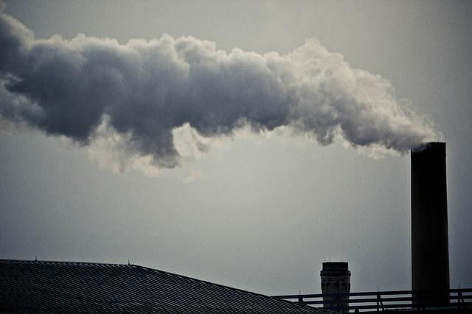
PFAS Source Track Down in Cooperation with Site Remediation and Air Programs
A research and implementation effort to identify potential sources of Perfluoroalkyl Substances (PFAS) to NJ’s environment
  Review of identified contaminated wells and surrounding industrial facilities
  Review of NAICS and SIC codes to determine likely, potential sources,
  Review of air permits
  Site inspections, working with DEP Compliance and Enforcement, in determining the occurrence, fate and transport of PFAS by examining methods of use and current pollution controls.

Slide 33
Health-Based Standard Setting for PFASs
PFNA (Perfluorononanoic Acid) –MCL adopted September 2018 – 13 ng/L
PFOA (Perfluorooctanoic Acid) – DWQI recommended MCL – 14 ng/L
PFOS (Perfluorooctanoic Sulfonate) – DWQI recommended MCL – 13 ng/L

Slide 34
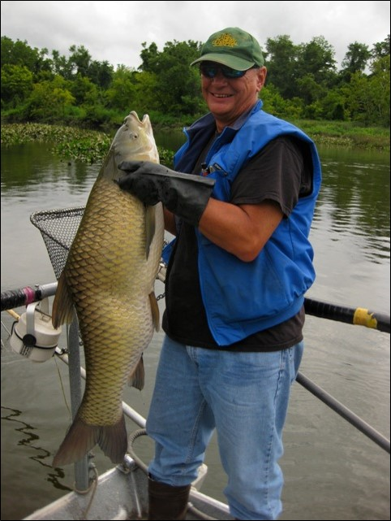
Monitoring and Targeted Research of Selected Chemical Contaminants in New Jersey Fish
Task 1 - Routine Monitoring of Toxics in Fish
  Includes the monitoring of fish tissue statewide, evaluating multiple target contaminants, fish species and water bodies;
  Informs the appropriateness of current fish consumption advisories and need for modifications;
  Examine new species, contaminants, and waterbodies; and
  Support education and outreach efforts in protecting the public.
Bruce Ruppel, DSREH

Slide 35
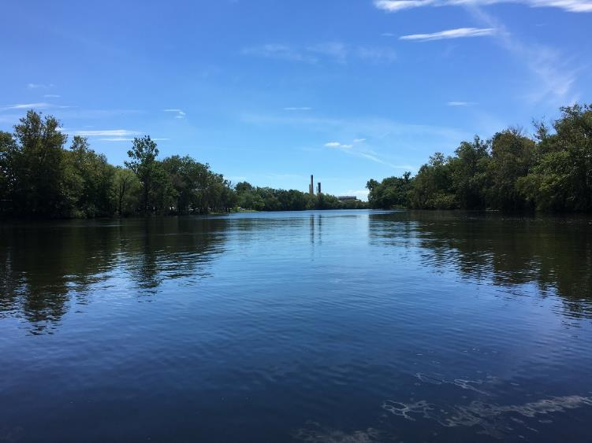
Monitoring and Targeted Research of Selected Chemical Contaminants in New Jersey Fish
Task 2- Investigate Levels of Perfluoroalkyl Substances (PFAS) in NJ Fish Species
  As an emerging compound, PFAS, particularly PFOS, have been found to accumulate in fish tissue if a source is present.
  Contamination has been identified in public and private drinking water wells, and potential sources have been identified, NJ fish and consumers may be impacted.
  Concentrations in fish tissue will be quantified and evaluated along with health criteria.
Passaic River

Slide 36
Comprehensive Estuarine Fish Inventory Program: Great Bay-Mullica River – Year 3
Kenneth W. Able and Thomas M. Grothues, Rutgers University
Objectives: Assess the current status of New Jersey estuaries. Examine water quality, habitat characteristics, and distribution and abundance of fishes and ecologically important invertebrates such as crabs and jellyfishes
Benefits: These data are critical for recreational and commercial fisheries management programs within NJDEP and federal agencies to better understand the relationships between changing environmental conditions, larval and juvenile fish dynamics, stock assessments and in supporting the appropriate fishery management planning and decision making.

Slide 37
NJ’s Coastal Estuaries Inventory – year 3
Mark Sullivan and Steve Evert, Stockton University
Objective 1 – Foster cooperation with local stakeholders and colleagues through data collection, training, collaboration, and data transfer.
Objective 2 – Collect accurate and comprehensive scientific data that is relevant to multiple life stages of commercial and recreational species managed by DEP / ASMFC.
Objective 3 – Produce data reports for DEP fishery scientists in stock assessment and population model development.
Objective 4 - Develop protocols that are transferable to other systems/estuaries in NJ.

Slide 38
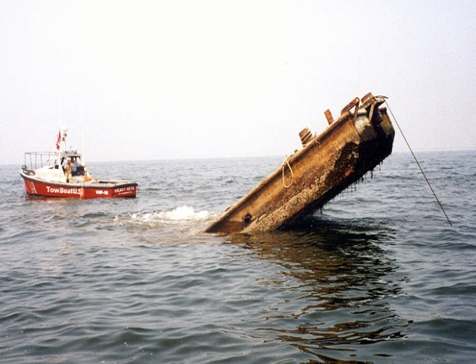
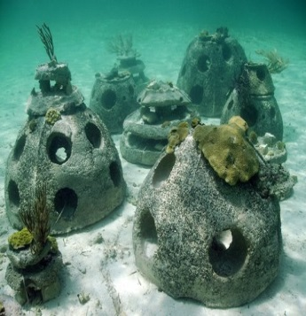
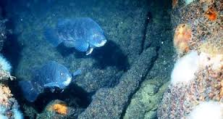
A Pilot Trap Survey of Artificial Reefs in New Jersey for Monitoring of Black Sea Bass, Tautog, and American Lobster – Year 3 (RUTGERS UNIVERSITY)
Objectives: 1) characterize seasonal and spatial variation in community composition and relative abundance of structure-associated species on artificial reefs off of the New Jersey coast and 2) to provide the information necessary to design a statistically robust trap survey for NJDEP fisheries management programs
Benefits - The data generated will provide:
A characterization of seasonal changes in the fish and invertebrate communities inhabiting two artificial reefs (i.e., Sea Girt and Little Egg Reefs).
A comparison between different artificial reef materials: Concrete-based structures and Metal structures.
Develop design recommendations for a long-term trap survey that can provide a statistically valid index of relative abundance for the three target species.

Slide 39
Division of Science and Research
Acknowledgements: DSREH Scientists, DEP Programs, Principal Investigators and their Universities
Director: Gary.Buchanan@dep.nj.gov
609-984-6070
Bureau Chief: Nick.Procopio@dep.nj.gov
609-633-7713
Information and Publications:
www.nj.gov/dep/dsr/
Check for new reports!

