Slide 1
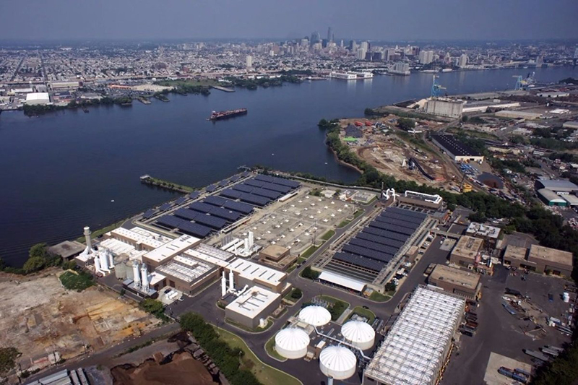
The Camden County MUA and Environmental Justice
September 2023
Timothy Feeney
Environmental Engineer in Training
Camden County Municipal Utilities Authority

Slide 2
CCMUA and Environmental Justice
Odors & Truck Traffic
Air Emissions
Plant Expansion
Combined Sewers
Digester and Biogas
Jobs Programs

Slide 3
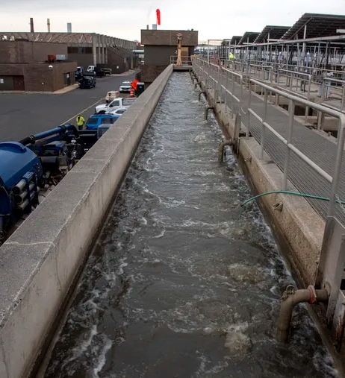
Progression of the CCMUA
Harmful to the Community
Do No Harm
Anchor Institution
EJ Law & The Future

Slide 4
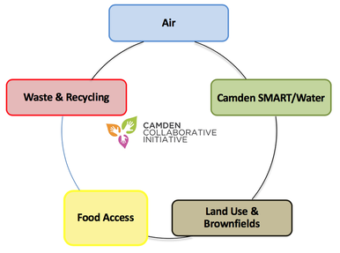
Environmental Management System & CCI

Slide 5
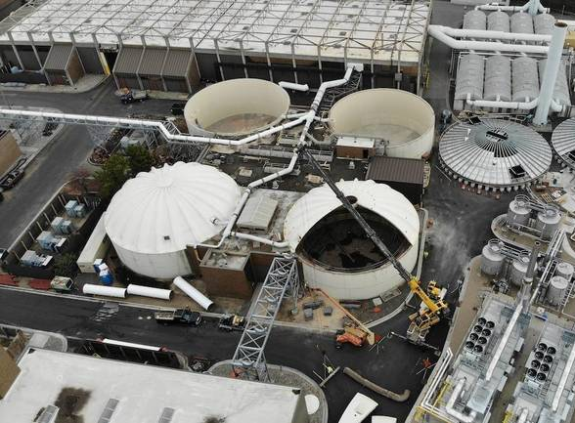
Anaerobic Digestion: A Case Study in Trade-Offs
Pros:
Reduced Odor
Reduced Trucking
Climate Change
Cons:
New Title 5 Emission

Slide 6
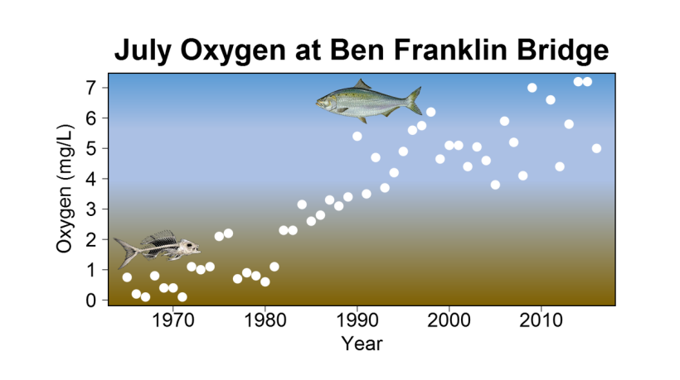
Plant Expansion and Ammonia Treatment
Expanded Footprint
Increased Emissions
Energy Demands

Slide 7
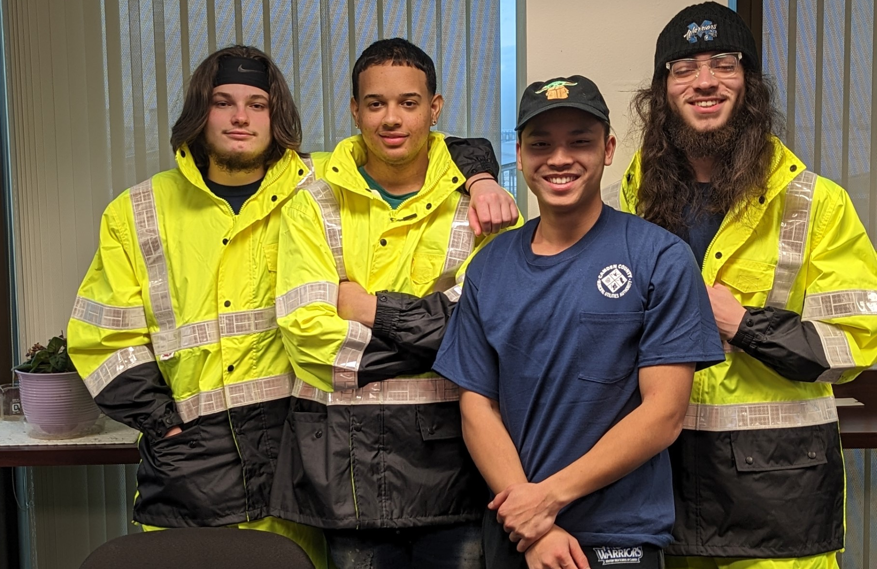
Jobs Program
Mastery High School of Camden Senior Workforce Program

