Slide 1
Compliance & Enforcement Division of Air Enforcement
November 17, 2017
Richelle Wormley, Director

Slide 2
PARTNERSHIPS

Slide 3
Partnerships(cont’d)
EPA Region 2
Alternate Compliance Monitoring Strategy Plan
Enforcement Cross Media Training
Odors– Water/ Solid Waste/UST
Used Oil Heaters/Emergency Generators – UST Staff

Slide 4
Permitting Staff Cross Media – Permit Writer currently in Region – training on inspections, reports, reviews…etc
Tampering Collaboration with EPA HQ/Region 2

Slide 5
SUPPLEMENTAL ENVIRONMENTAL PROJECTS

Slide 6
Supplemental Environmental Projects in 2017
Electric Charging Station
Seaside Heights – 3 level 2 dual port 240 V electric charging stations
Urban Farming
Elizabeth – Community Gardens
Tree Planting Newark
Over 50 trees in and around Newark

Slide 7
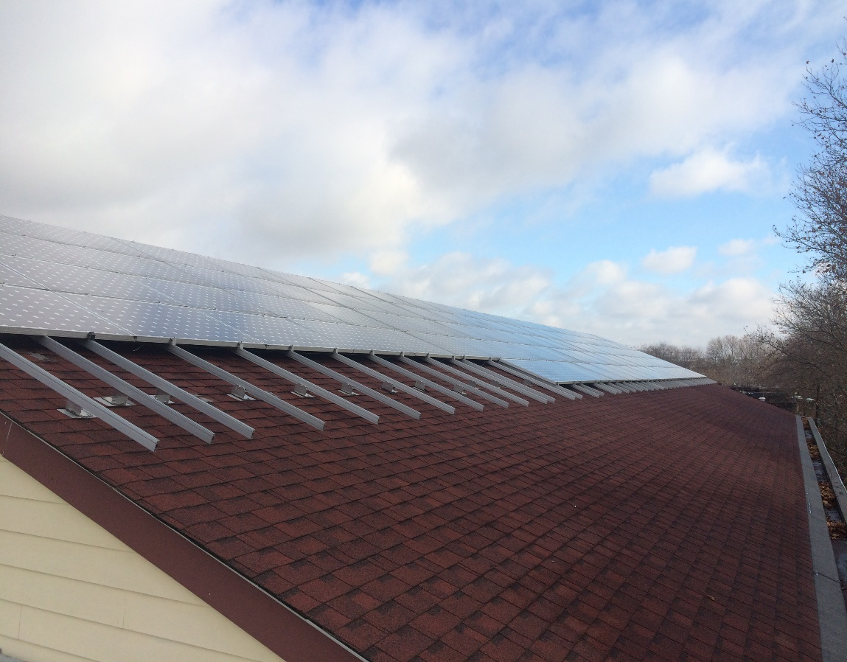
Solar Panel –Sacred Heart Community Center, Camden, NJ

Slide 8
Supplemental Environmental Projects (cont’d)
Air Monitoring System at Paulsboro High School
Removing old air monitors and replacing them with ambient air monitors for hydrogen sulfide, hydrogen fluoride, and sulfur dioxide.
The monitoring system is being integrated with the existing school gymnasium pressurized shelter in-place.
WILL MAINTAIN the monitoring system to include quarterly calibrations/verification events

Slide 9
Upcoming
Continuing to reallocate resources to find and fix environmental problems
Air Compliance and Enforcement (ACE Academy)
Training on May 9, 2018

Slide 10
Questions

