Slide 1
Resiliency & air toxics rule
A&WMA November 16, 2018

Slide 2
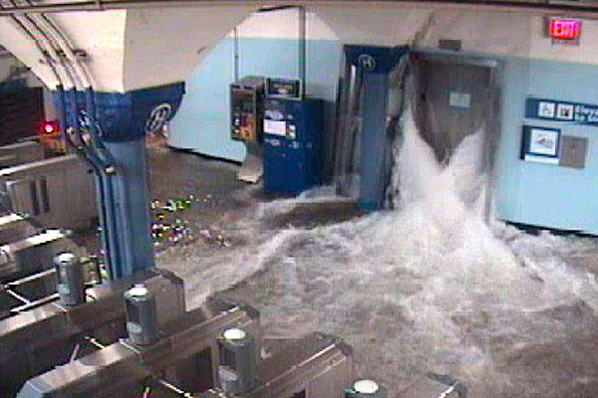
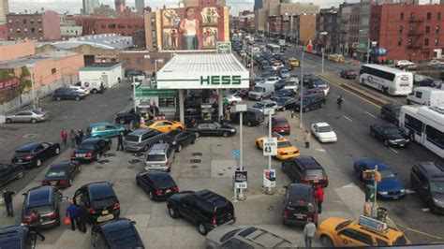
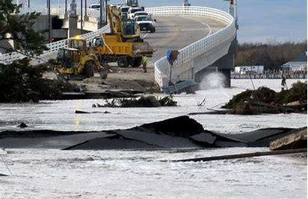
Why?

Slide 3
rulemaking
Proposed (Publication) | Adoption | Effective (Publication) | Operative
8/7/17 49 NJR 2373(a) | 12/14/17 | 1/16/18 50 NJR 454(a) | 2/12/18

Slide 4
resiliency
Exempt from permitting: portable equipment used for emergency management activities
N.J.A.C. 7:27-8.2(d)17
Does not exempt equipment used for incineration/open burning
Does not include equipment located on site for more than 90 consecutive days
Removal of 500 hours restriction for burning fuel oil during curtailment of natural gas supply
Notes:
Engines powering portable equipment
CRM equipment
Rental equipment at a rental facility
Portable paper/hard drive shredders
Conveyance and baling of source-separated materials
Excavated materials placed directly into transportation vehicles

Slide 5
Resiliency - definitions
“Emergency management activity” means an activity to mitigate against, prepare for, respond to, and recover from threatened or actual natural disasters, acts of terrorism, or other man-made disasters.
“Portable” means not attached to a permanent foundation, and designed and capable of being carried or moved from one location to another by means of wheels, skids, carrying handles, dolly, trailer, platform, or similar device.

Slide 6
Exemptions for low-emitting temporary and portable equipment from permitting
Construction, Repair, & Maintenance (CRM)
N.J.A.C. 7:27-8.2(d)15 & 16
Rental facilities (testing/maint/demo only)
N.J.A.C. 7:27-8.2(d)18
Portable hard drive and paper shredders
N.J.A.C. 7:27-8.2(d)19
Excavation and transfer of soil/sediment directly into vehicle
N.J.A.C. 7:27-8.2(d)20
Baling/conveying of glass, plastic, cans, cardboard, and paper
N.J.A.C. 7:27-8.2(d)21

Slide 7
Permit exemption for CRM
CRM Equipment
Portable
Limited to 1 year
Equipment used to temporarily replace commercial fuel burning equipment
Portable
Located on site no longer than 90 days (can’t move on/off)
Below State of the Art (SOTA) thresholds
Notification to Enforcement
Prior to operation
Within 30 days after operation ceased

Slide 8
Use of emergency generator for crm
Emergency generators used during infrequent non-emergency power disruptions
Power disruption that results from CRM
Limited to 30 days in any calendar year, not including normal testing and maintenance

Slide 9
Air toxics
Updated reporting thresholds
Most recent science and technology
Consolidated all reporting thresholds to N.J.A.C. 7:27-17
Move from N.J.A.C. 7:27-8 & 22
Updated N.J.A.C. 7:27-21 to reference N.J.A.C. 7:27-17
Notes:
Used IRIS, supplemented w/CA

Slide 10
New thresholds
185 of the 187 Federally listed HAPs (same # as before)
~65% decreased
Benzene: 400 lbs/yr to 6 lbs/yr (petroleum products)
Methyl bromide: 2,000 lbs/yr to 230 lbs/yr (fumigation)
Tertrachloroethylene 2,000 lbs/yr to 180 lbs/yr (dry cleaners)
~20% increased
Acetonitrile: 800 lbs/yr to 2,000 lbs/yr (synthetic rubber prod)
Phenol: 20 lbs/yr to 2,000 lbs/yr (resin prod)
Vinyl acetate: 200 lbs/yr to 2,000 lbs/yr (PVC prod)
Additionally, 11 TXS have 2nd reporting thresholds of 0.01 lbs/hr
No change in SOTA thresholds
Notes:
Latest health benchmarks (USEPA, CalEPA, and ATSDR)
Latest USEPA approved model
Representative meteorology from recent years
Representative stack parameters

Slide 11
Consolidation of reporting thresholds to N.J.A.C. 7:27-17
Reporting requirements for permitting still reside in N.J.A.C. 7:27-8 and 22
Operating permits (N.J.A.C. 7:27-22)
New or modified filed on or after 2/12/18
Renewals (no mods) with expiration date on or after 2/12/21
Preconstruction permits (N.J.A.C. 7:27-8)
New or modified only filed on or after 2/12/18
GP/GOP risk assessment done as part of development
Emission Statement (N.J.A.C. 7:27-21)
Starting with 2018 emissions (reported in 2019)
Notes:
New table in Sub 21 Appendix with old threshold for 2017 reporting use only

Slide 12
Revisions to Technical manuals
Technical Manuals
1002 – Guidance on Preparing an Air Quality Modeling Protocol
1003 – Guidance on Preparing a Risk Assessment for Air Contaminant Emissions
Stakeholder process started in October 2017
Published notice in the March 19, 2018 New Jersey Register requesting public comments
Final updated Technical Manuals will be available beginning on December 3, 2018 at https://www.state.nj.us/dep/aqpp/techman.html

Slide 13
Technical manual 1002
National Ambient Air Quality Standards updated
Model selection information revised to be consistent with revised 40 CFR Part 51, Appendix W, Guideline on Air Quality Models
Updated background air quality information and guidance provided
Improved meteorological data section with meteorological station details
Special modeling considerations included
Risk assessment modeling guidance
NOx to NO2 conversion ratio

Slide 14
Technical manual 1003
Risk screening worksheet to be revised consistent with
Current air quality models
Recent meteorological data
Procedure for facility-wide risk assessment outlined
Deletions made
Applicability for having to conduct a risk assessment
Comprehensive risk assessments

Slide 15
Useful webpages
NJDEP - http://www.nj.gov/dep/
Air Regulations - http://www.nj.gov/dep/aqm/
Air Permitting - http://www.state.nj.us/dep/aqpp/
Evaluation & Planning - http://www.nj.gov/dep/baqp/

Slide 16
Contact information
Danny Wong
Bureau of Stationary Sources
401 E. State Street, 2nd floor
P.O. Box 420,
Mail Code 401-02
Trenton, NJ 08625-0420
Telephone: (609) 292-6716
Fax: (609) 292-1028
E-mail: danny.wong@dep.nj.gov

Slide 17
questions?

