Slide 1
Keyann'a watkins
Volunteer coordinator
Office of the Mayor, Camden

Slide 2
About keyann'a
Passionate Community Advocate: Born and raised in Camden, NJ, Keyann'a's commitment to serving her community drives her work as a dedicated environmental leader
Academic Achievements: In 2023, Keyann'a graduated from Rutgers University-Camden School of Business with a Bachelor's Degree in Marketing and a minor in Human Resources
Current Role: Keyann'a is the Volunteer Coordinator for the Mayor's Office of Camden, where she plays a pivotal role in coordinating outreach efforts to volunteers, community agencies, and corporate sponsors

Slide 3
Paving the Way for a Sustainable Camden
Clean Camden Campaign: In its third year under Mayor Victor Carstarphen, the Clean Camden Campaign conducts a series of neighborhood cleanups aimed at preserving the cleanliness and beauty of Camden, while promoting environmental stewardship
Comprehensive Collaborative Approach: Collaboration with a wide range of stakeholders has allowed for a comprehensive approach to address not only environmental concerns but also broader community health and safety issues, ultimately elevating the quality of life for residents
Visible Community Impact: The program has acted as a catalyst, fostering shifts in attitudes and behaviors, as well as the adoption of practices that result in reduced waste, emissions, and other factors contributing to blight

Slide 4
Inclusivity in Environmental Awareness
Environmental Education: Promote inclusive environmental education programs, raising awareness about environmental risks and empowering residents from all backgrounds to advocate for equitable solutions.
Empowerment and Participation: Encourage the active participation of residents in environmental decision-making through advisory boards and co-design processes, ensuring that diverse perspectives are included for more inclusive outcomes
Long-Term Engagement: Maintain ongoing engagement with community stakeholders, recognizing that trust-building and sustained commitment are essential for addressing complex environmental challenges over time

Slide 5
...
\
\
\
1
- I
.-t.-.a.1. / \ I
' --. ...., - ...I Y
t
I
Erielys Vicente Program Coordinator

Slide 6
Entre reneurs z
•
MAP.P.M EARliM DAV. -•
Wormington &c Friends:
TheZ·nnia

Slide 8
STEM Education
Wormin,gton & Friends:
The Zinnia
Wormington & Friends: Camden's Circut Trails
Wormington
& Friends:
The Stormwater Scare
f r\
.- -
..
f
!I " ,
,, /
,
, .
....' 1/
,t
6·
/
-
Illustrations
By: Erielys Vicente
Created By: Mastery High School Garden Club
''first they get dirt, compost , peat moss, llim e, "You make 'black gold' which is an
ond perlite; to make their own potting soil organic fertilizer made by worms
"The Circut trail is a family friendly trail for people to enjoy nature in fun places like parks, gardens, waterfronts and bike routes!"
''Sure!
11
''Right this way then!"
by sifting it t"
breaking down compost!"
Tr a il Status
C!'J -
E>tls ting
Existentes
In Progress
EnptOQr«JO
Plpellne
Aconbnuacldn
C!'J
PJ -
FAMOUS?!. A
STAR? Like, a
SUPERSTAR?!''
"Oh? I've still never heard of it before:'
"Oh? ⁵⁰ you've never ..... ,,...... walked or flown the
trail before?"
''Yeah! They add your new compost to their soil to give it nutdents!"
''But what about you Be,eliy?''
"Cool, huh? Its a park being used to heal the earth with all the new trees! It also gives us safe access to the Delaware River to fish and go kayaking! Its Cramer Hills new source of pride and hope!
\
\ \ 1\ -
\-

Slide 9
Touching the Hearts of the Communit

Slide 10
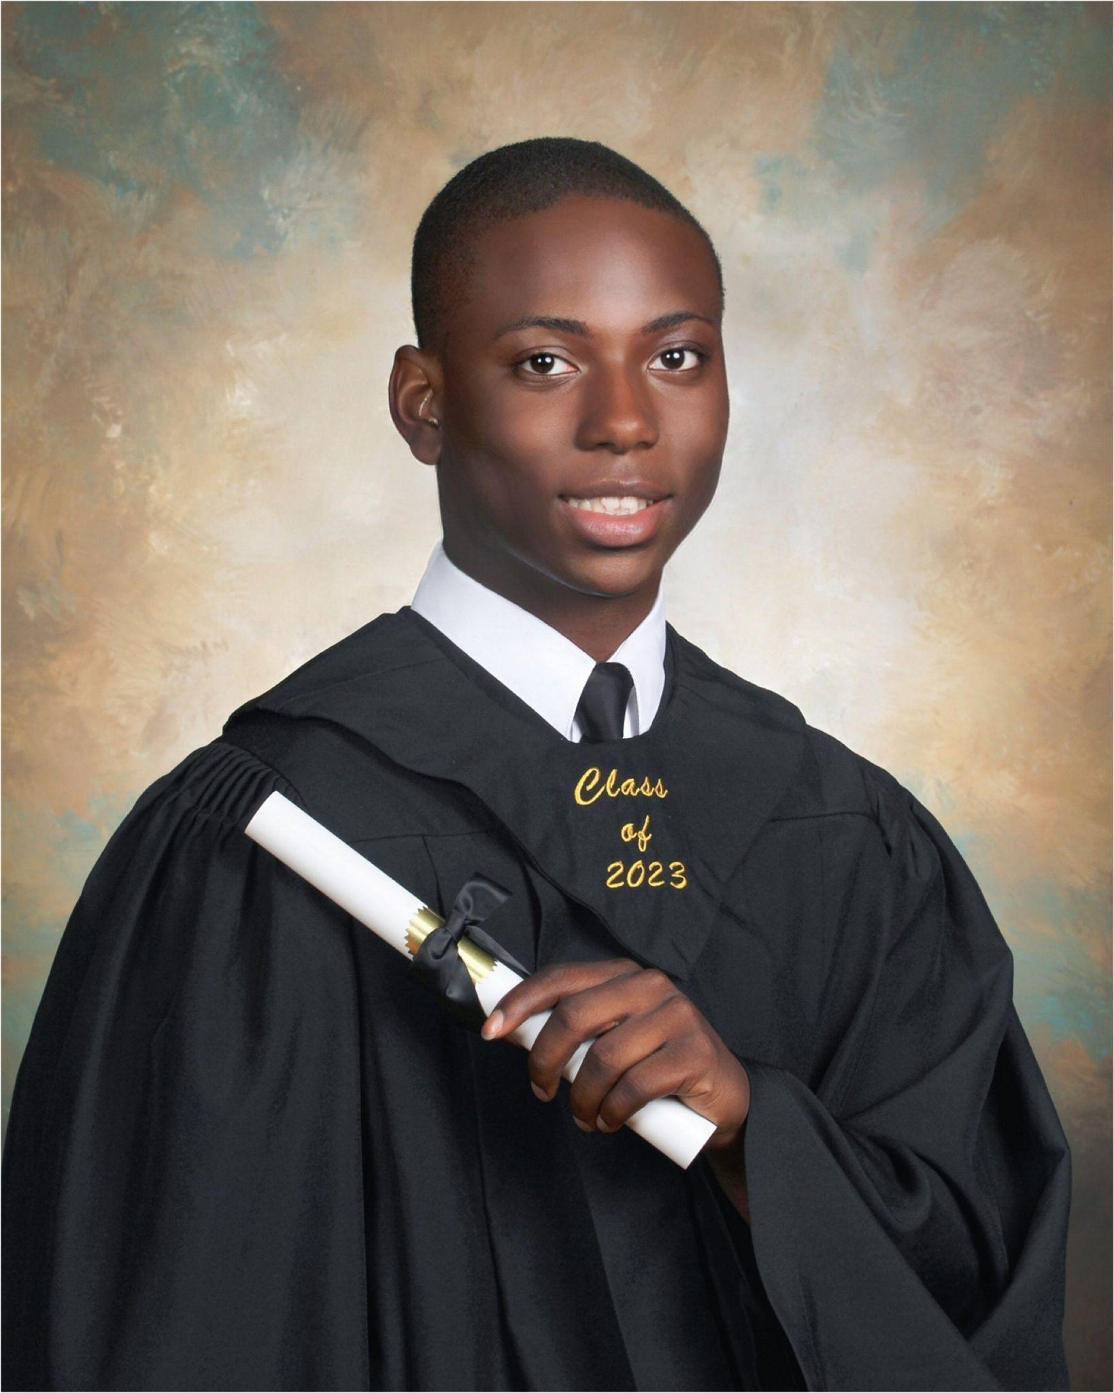
Uzziah Davis
From Camden, NJ
Deptford High alum
PoliSci Major at RU-C
Waterfront South

Slide 11
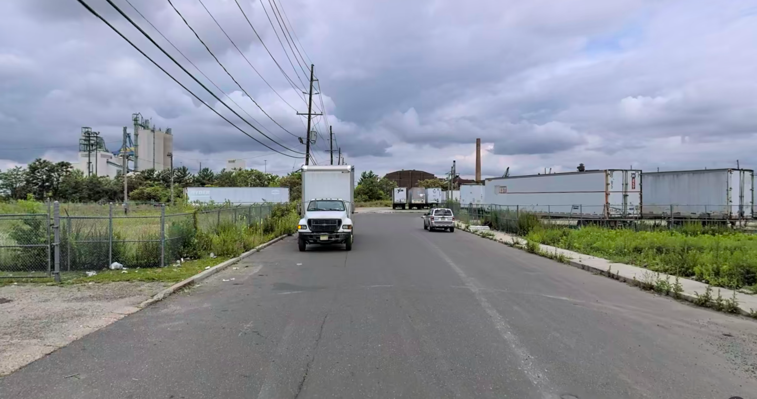
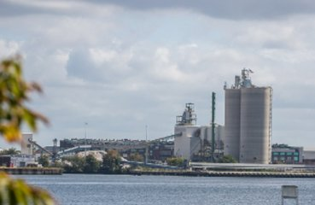
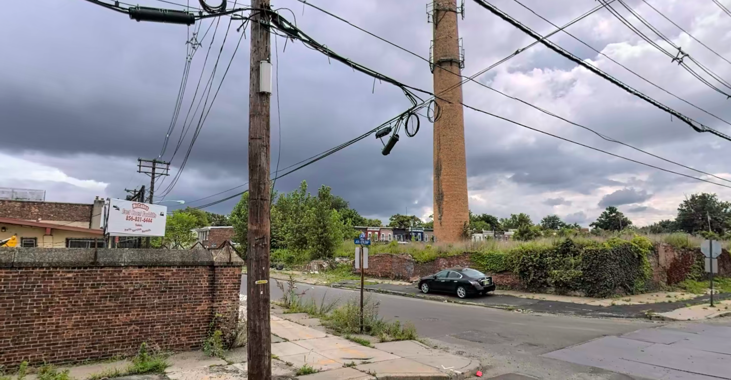
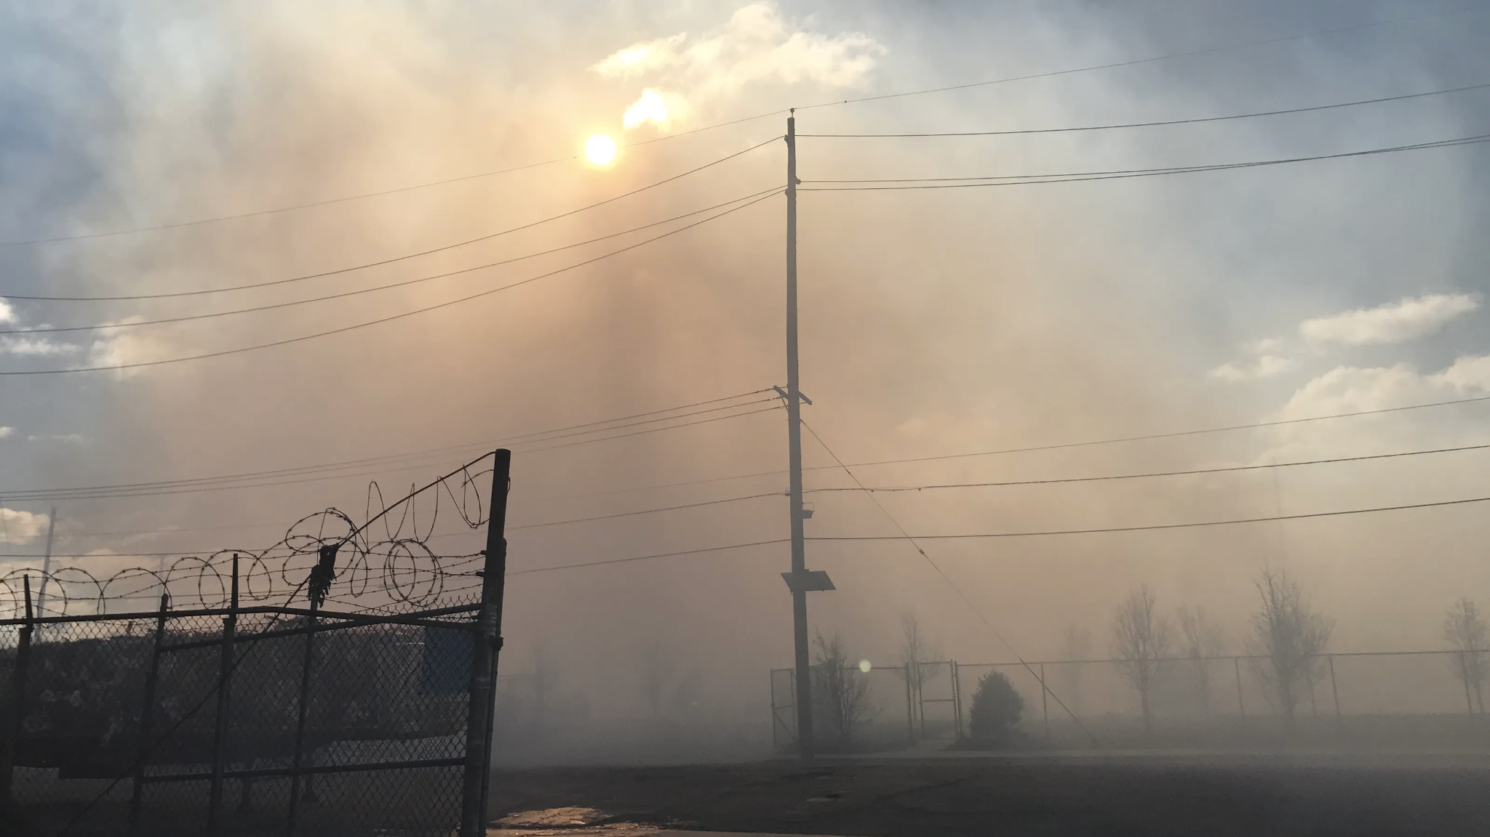
Waterfront South

Slide 12
Most Pressing Issues in the Area
Systemic inequality in locations of environmentally hazardous sites
Respiratory effects of air pollution in children
Lack of knowledge on environmental justice in the general public

Slide 13
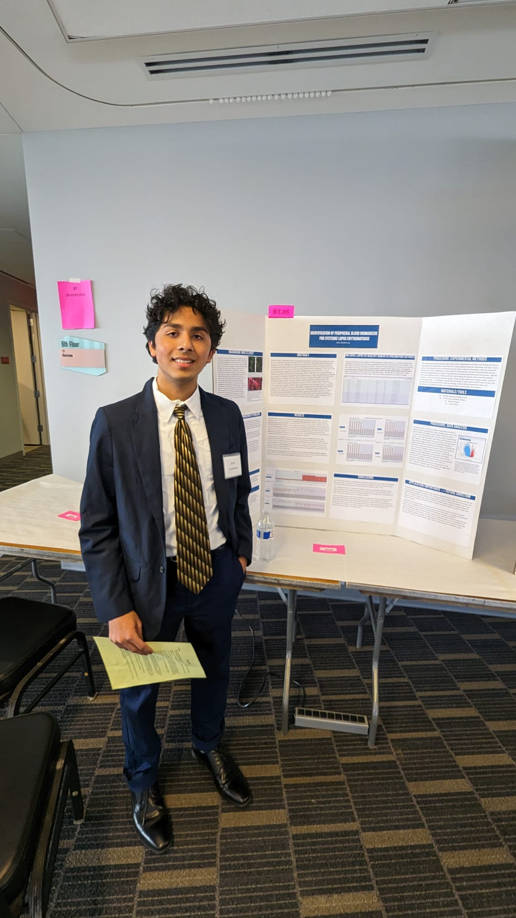
Arin Harkawat
Hi, my name is Arin Harkawat
Junior in high school attending Watchung Hills Regional High School in New Jersey
Interested in intersection between Environmental Justice and Health, specifically air pollutants
Director of Advocacy at the Environmental Justice Coalition
Most of my work pertains to Environmental Health and Justice research, especially here at Rutgers

Slide 14
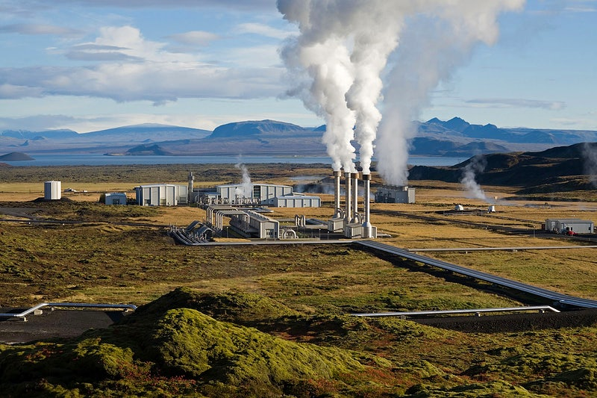
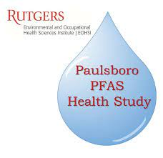
Research
Majority of the research I do pertains to
Air Pollutants and Toxic Compounds (such as PFAS) with Dr. Laumbach here at Rutgers
Areas which affect water quality such as Cryptosporidium and its detection through DNA extraction
Correlations between SES variables on Environmental determinants and Environmental benefits, especially in Mexico and Washington
Some of my independent work has been analysis of Pollution Prevention methods through the EPA and establishing organic biofilters for cleaning water
Notes:
Air Pollution Image Link
Paulsboro Image Link

Slide 15
Advocacy
As the Director at the Environmental Justice Coalition (EJC) some of the work I’ve done has been
Constructing policy briefs for acts such as the NJ-NY Watershed Act
Beginning to work as TA’s in partnership with Smart Growth America
Work with other directors to advocate and establish sustainability initiatives in New Jersey and Virginia
Recently started a pollution prevention organization/working group, Eviryo, working towards partnerships and advocacy in the Mid-Atlantic Region
Notes:
Environmental Justice Coalition Image Link

Slide 16
Pressing Issues
The scope of Environmental Justice has a wide range of problems, and ongoing solutions
Pressing issues include:
Water Accessibility and Clean Water
Reduction of Pollutants and Toxic Chemicals
Unique approaches to Environmental legislation and policy
Disproportionate environmental issues marginalized and BIPOC communities face
Continued youth involvement, especially for high school students, is a step we should be taking → Various mediums in doing so: input in legislative decisions, working in establishing advocacy campaigns, creating platforms to hearing youth perspective and voice, etc

