Slide 2
Covanta at a Glance
For more than 40 years, Covanta has been at the forefront of sustainable materials management, providing world-class waste and resource solutions that serve people, the planet and a more prosperous future.
Our Vision
Our Business
Our Value
Covanta is leading the charge to a carbon-negative future through revolutionary sustainable materials management solutions that reduce, reuse, recycle and reimagine waste for the benefit of society and the environment
Covanta provides diverse and scalable full-service solutions that move businesses and communities up the waste hierarchy to optimize their resource use, reduce their carbon footprints and achieve their ESG goals
Covanta’s differentiator comes from our ecosystem of technology, facilities and partnerships, trusted by the world’s largest organizations to deliver transparent and reliable solutions every day​

Slide 3
Leader in Sustainable Materials Management
Over 50 sustainable material processing facilities, including EfW facilities in North America
Annually recycle approximately
600,000 tons of metal
the equivalent amount of steel can build six Golden Gate Bridges
Annual capacity to process 21 million tons of waste
4,500 professionals employed in North America
Generate 10 million megawatt hours—enough clean energy to power over 1 million homes
High focus on improving sustainability and encouraging a circular economy

Slide 4
Driving ESG Leadership
Environmental
Social
Governance
Waste-to-energy is a major source of net carbon-negative energy, outperforming wind and solar when benefits of avoided landfill methane are considered
Making a positive, significant difference for the people we serve, the planet we share and the future we seek
Aligning sustainability strategies with business growth from the top down, holding leadership accountable for meeting targets and driving continuous improvement
Greenhouse Gases
19+ MILLION
METRIC TONS REDUCED ANNUALLY
Relative to landfilling, equivalent to removing nearly 4 million cars
Commitment to Communities
6,0000+ ACTIVE EMPLOYEE HOURS
each year, supporting community initiatives through volunteering, fundraising and education
Financial & Sustainability Goals
First-ever sustainability-linked financing framework in the U.S. to drive ESG goals
Prioritizing Workplace Safety
30+ FACILITIES
awarded OSHA’s prestigious VPP Star status, by far the most in the industry
Advocating for Equity
Supported landmark New Jersey Environmental Justice (EJ) law; Targeted facility upgrades in EJ communities
Green Energy
10.3+ MILLION
MWHs GENERATED ANNUALLY
20
Fostering Diversity
of leadership positions held by women and racially diverse groups and growing
Delivering Transparency
Publicly available, continuous emissions monitoring and reporting
Valuable Materials
1 MILLION+
TONS RECYCLED & REUSED ANNUALLY
%
550,000 TONS
of recovered metals
100 MILLION
gallons of wastewater beneficially used
Stimulating Local Economies
40%+ SPEND
with local suppliers and vendors
Technology Advancement
$1 BILLION+ SPENT
on infrastructure enhancements

Slide 5
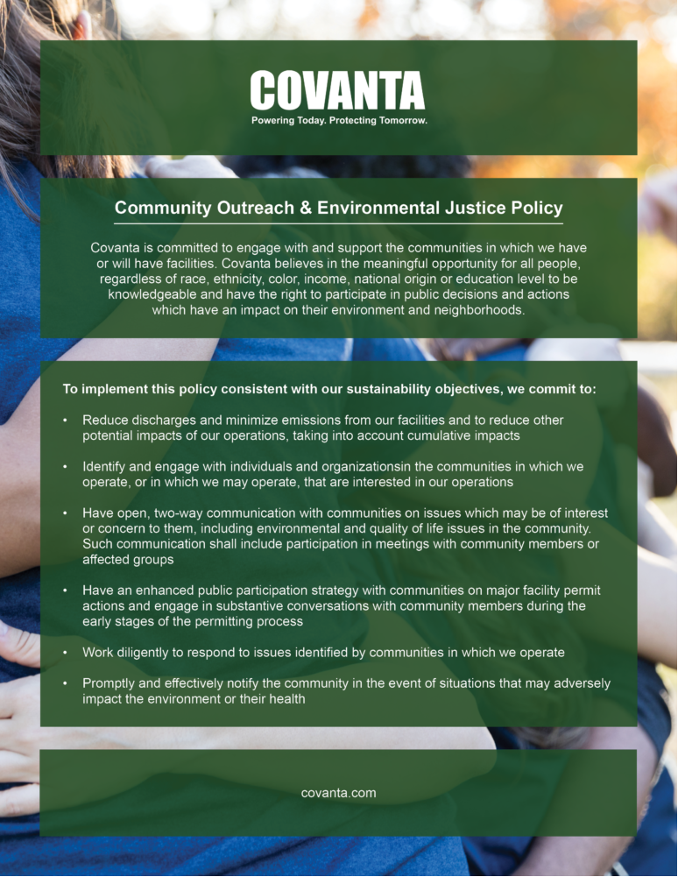
Community Outreach & Environmental Justice Policy
We are committed to:
Identify and engage with individuals and organizations in the communities in which we operate, or in which we may operate, that are interested in our operations.
Having open, two-way communication with communities on issues which may be of interest or concern to them…
Having an enhanced public participation strategy with communities on major facility permit actions and engage in substantive conversations with community members during the early stages of the permitting process.

Slide 6
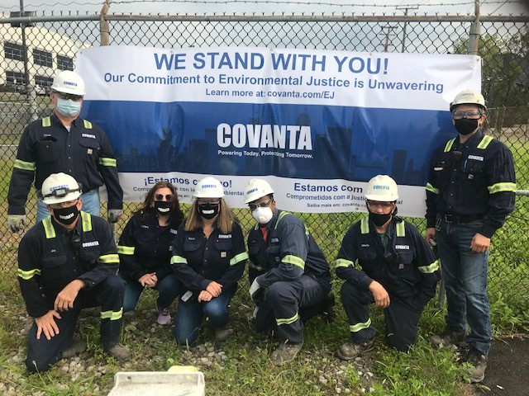
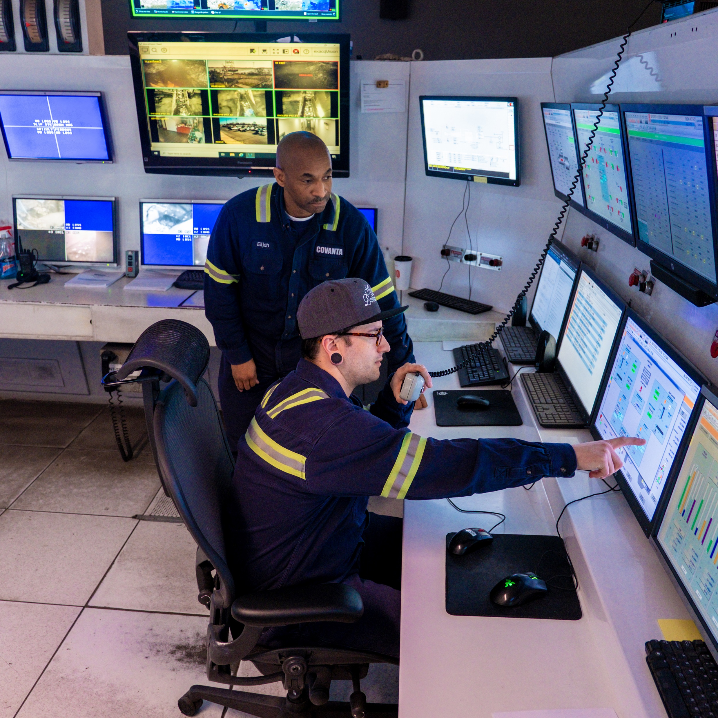
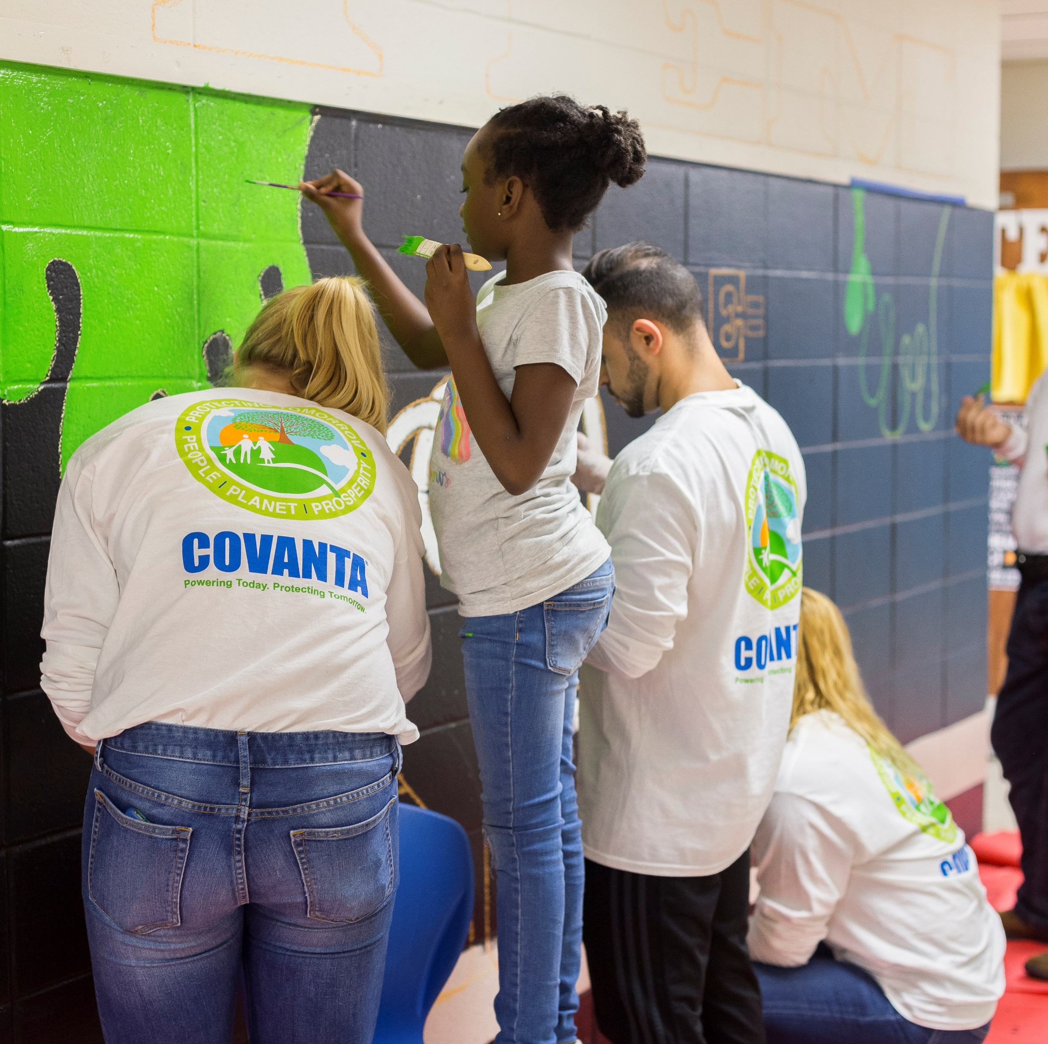
Covanta & Environmental Justice
Investment
Engagement
Transparency
Scan the QR Code
Over the last 10 years, we’ve invested half a billion dollars into our sites
$90M emissions enhancement investment in our Newark, NJ facility, reduced emissions over 90%
Most recently, $60M emissions enhancement is in permitting for Camden, NJ facility includes Community Benefits Agreement
We commit over 6,000 active employee hours each year to community initiatives
Efforts include: job training, scholarships, food insecurity programs, clean ups, coat drives and more
First supporter of NJ’s EJ legislation in our industry
Open lines of communication with communities is key
We post real-time emissions data online for our NJ, PA, NY, MA, FL sites with more to come
We host community members at our facilities and participate in public hearings
Learn more about what we do to support our local communities

Slide 7
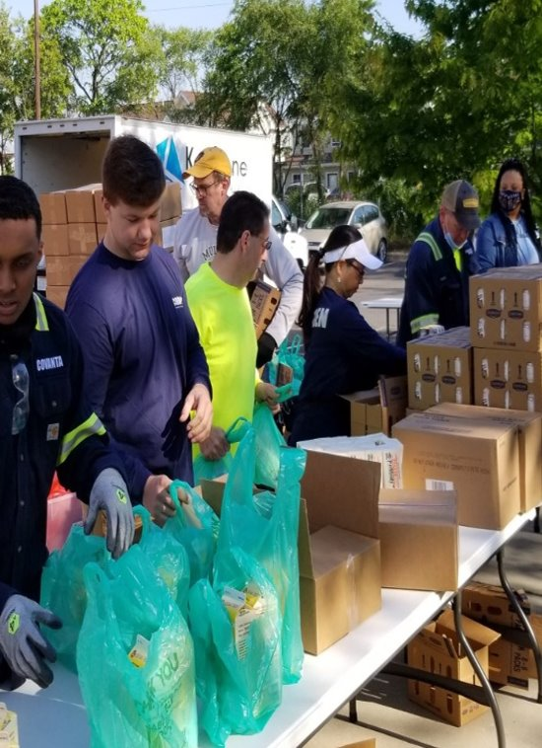
Going Beyond a Good Neighbor
Industry first Environmental Justice Policy in 2011
Over the last 10 years, we’ve invested half a billion dollars into our sites to stay on the cutting edge of technology
84% of facilities participate in 10+ services events and initiatives
We have had 165,000 (and counting) students visit our sites to educate the next STEM leaders of the future
Our facilities drive economic activity through a wide of services and on average stimulate local economies by 15-40% through spend with North American suppliers

Slide 8
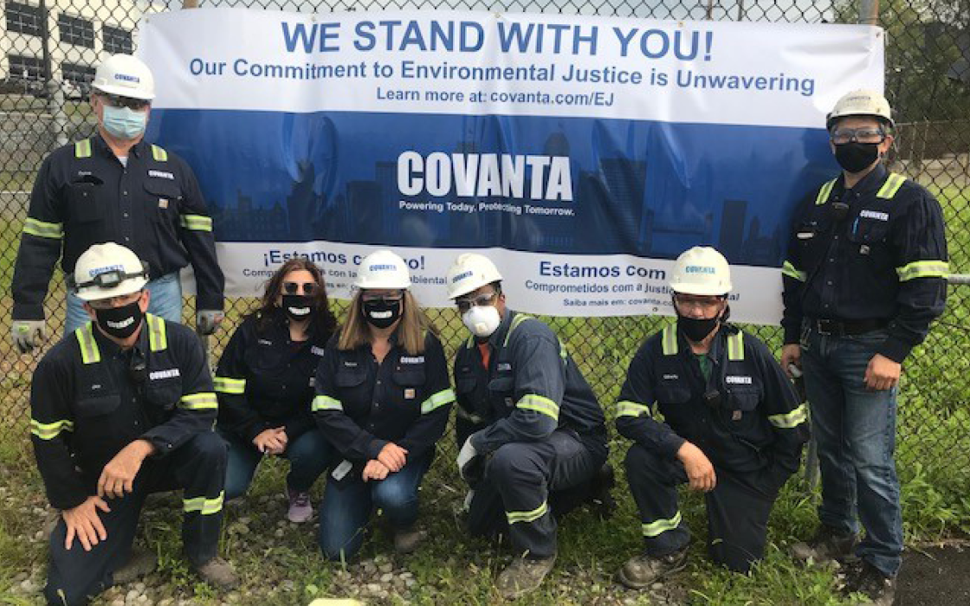
Environmental Justice for Covanta: Not Just Words, ACTION!
New Baghouses
Newark, NJ
Huntsville, AL
Hillsborough, FL
SEMASS, MA
New NOx Controls/Reductions
Newark, NJ
Fairfax, VA (WIP)
Huntsville, AL
Alexandria, VA (WIP)
Stanislaus, CA (in design)
SEMASS, MA
Haverhill, MA
In Planning/Permitting
Camden, NJ ‐ Baghouse
Chester, PA ‐ NOx Reduction

Slide 9
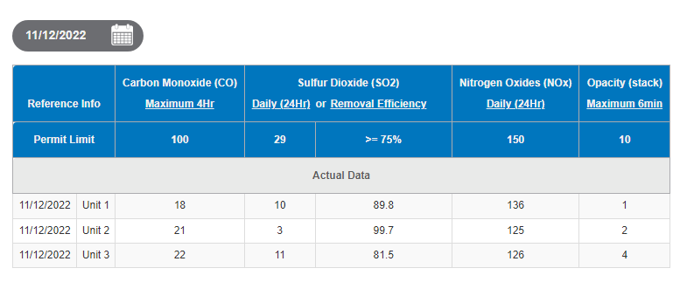
Communication: Environmental Performance Transparency
Notes:
Main Point:
In 2021, Facility started showing continuous emissions monitoring data to the public on our website.

Slide 10
Covanta Camden Camden, NJ
The Covanta Camden Energy Recovery Center is an award-winning Waste-to-Energy Facility that serves the municipalities in Camden County and the surrounding region with reliable and sustainable waste management.
We ensure less waste goes to landfills which reduces greenhouse gas emissions by 345,000 tons of CO₂e
-Enough to take 68,000 cars off the road for 1 year.
We manage waste from the Camden County to produce 21 megawatts of electricity 24/7, powering 15,000 homes in a year.
We recover 15,800 tons of metal for recycling annually - enough to build 13,000 cars.
Notes:
Plant was opened in 1991, Covanta took over the operations about ten yeas ago.
Plant process just over 400,000 tons of Municipal Solid Wate or Trash.
400,000 tons is equal to filling a 289-football field's with trash 1 foot high.
The plant operates 24 hrs a day 7 days a week exporting 21 Megawatts a hour.
21 Megawatt is enough electricity to power 15,000 homes or arond 60% of all the households in Camden.
The facility recycles about 15,800 tons of Metal each year. Enough metal to build 13,000 cars.

Slide 11
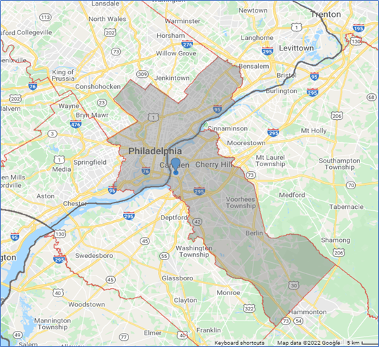
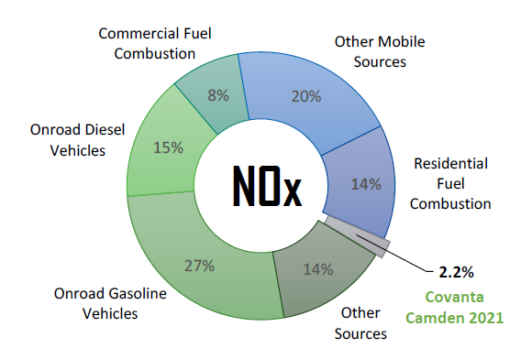
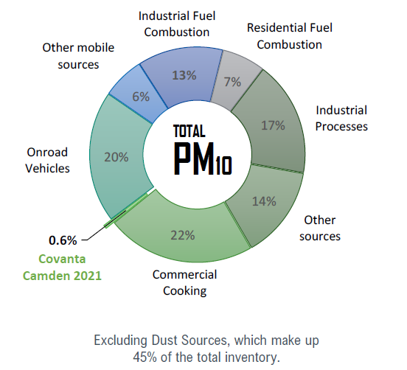
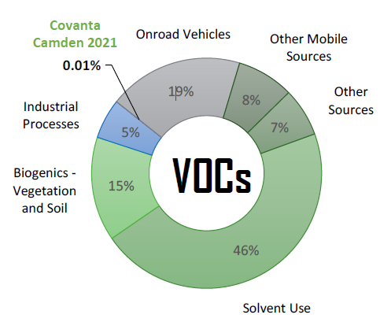
How Do Our Emissions Compare to Other Sources in the Air Shed? Local air emissions* in Camden County, NJ & local area (see map)
Nitrogen Oxides
Particulate Matter
(less than 10 microns)
0.01%
Covanta Camden (2021 data)
2.2%
Covanta Camden (2021 Data)
1.7%
Covanta
Camden 2020
0.6%
Covanta Camden (2021 Data)
0.9%
Covanta
Camden 2020
Volatile Organic Compounds
* Based on the 2017 US EPA National Emissions Inventory; the most recently released complete inventory. Where available, the facility’s 2017 emissions were replaced with the reported 2021 emissions.
Continuous Emissions Monitoring (CEMS) Data for CVA Camden can be found at:
https://www.covanta.com/where-we-are/our-facilities/camden
Notes:
Main Point:
This Slide and associated circle graphs show the percentage and sources of the air pollutions in the local air shed. Data is based off of EPA number and Covanta Camden actual numbers.
We show the graphs for Nitrogen Oxides, Particulate Matter and Volatile Organic Compounds.
Covanta is not a leading polluter in Camden County, in fact it’s contribution is small and is based on actual measurements.
While Covanta Camden’s emissions contribute to cumulative impacts, it’s not the biggest source, But we understand the need and is commitment to reducing our impact
We also focus on having transparent operations, which is why we post or daily emissions on out website as shown on the next slide.

Slide 12
Thank you
Lloyd Naideck
Director, Government Relations

